Slide 1
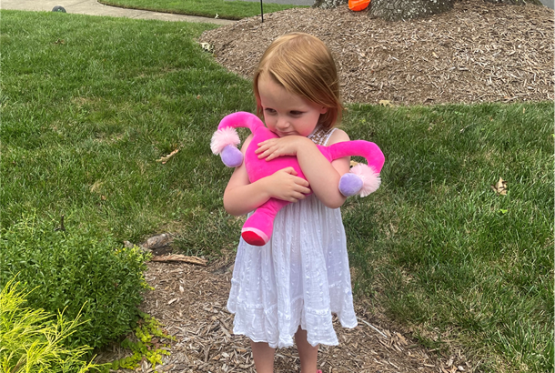

Slide 2
Periods, pcos & prolapse, Oh My!
An overview of common gynecologic complaints for pediatric & adolescent girls
Rachel Casey, MD FACOG
Pediatric and Adolescent Gynecology
Northern Virginia Pediatric Society 2022

Slide 3
Learning objectives
Describe
Describe normal pediatric and adolescent gynecologic anatomy and age-appropriate examination
Discuss
Discuss presenting symptoms, exam findings and management of common consults in pediatric and adolescent girls
Review
Review options for menstrual manipulation and contraception for adolescents

Slide 4
Prepubertal Problems
Puberty & Period Problems
Preventing Problems (& Pregnancy)

Slide 5
Part 1: prepuberty problems

Slide 6
Gynecologic Anatomy
Prepubertal
Pubertal
Notes:
Presence of pubic hair
Signs of estrogenization
Erythema or excoriation
Size of clitoris
Configuration of the hymen
Crescentic, annular or redundant
Determine patency
Try traction, different positions, deep breath
Probe with small q-tip (calgiswab)
Spray water with a syringe

Slide 7
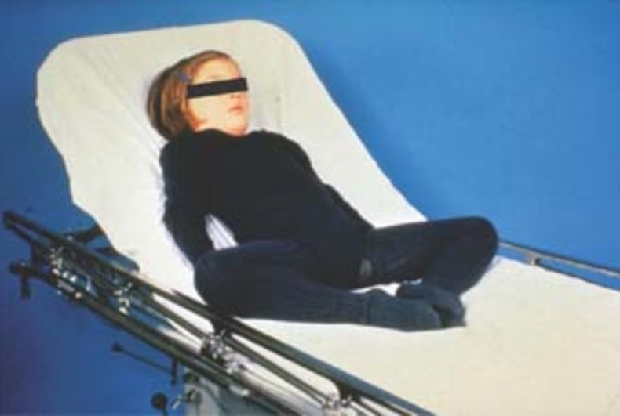
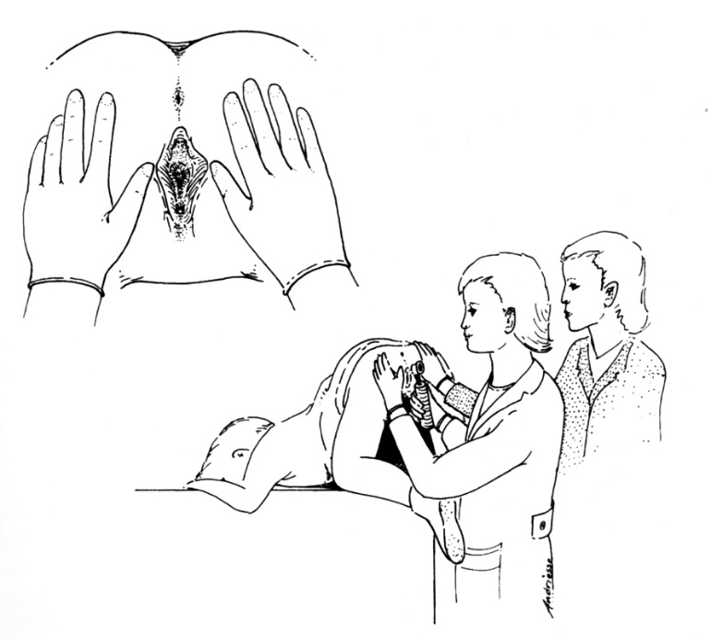
Gynecologic Exam

Slide 8
Gynecologic Exam

Slide 9
Gynecologic Exam

Slide 10
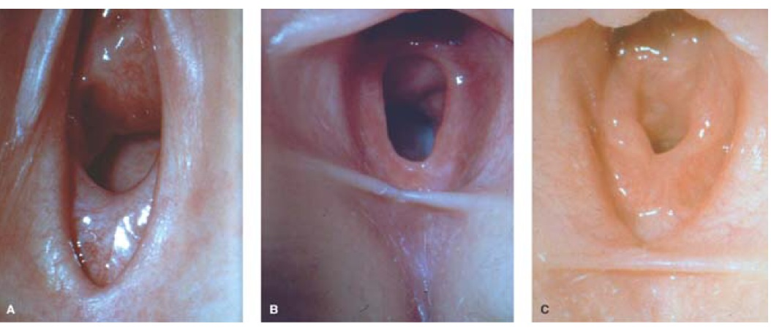
Hymeneal Exam

Slide 11
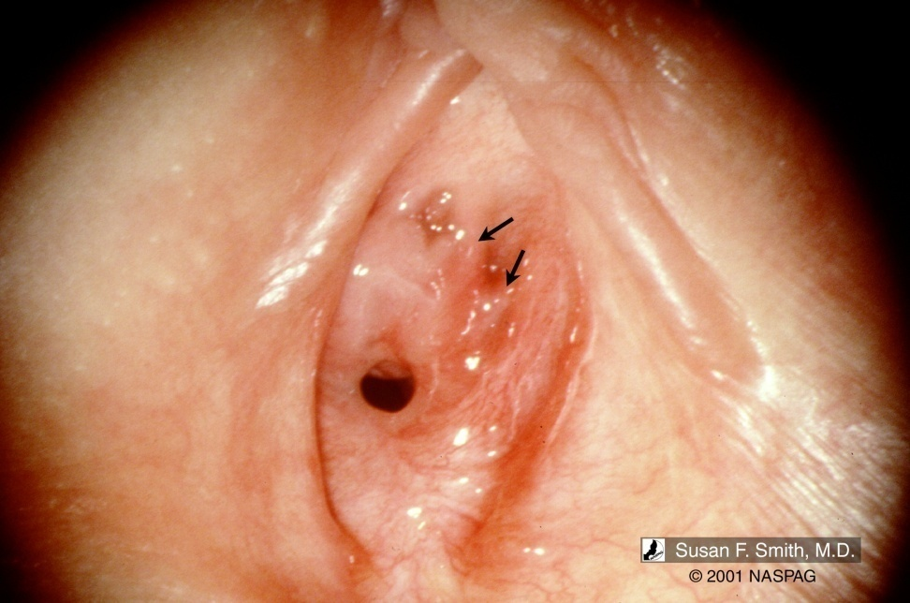
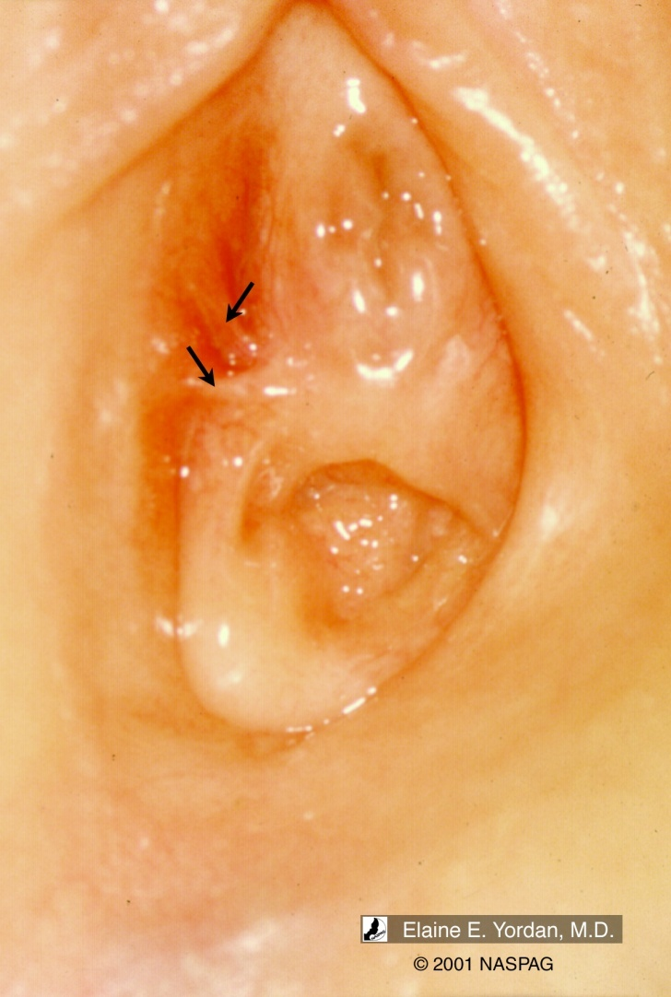
Hymeneal Variants
Notes:
Withdrawal of estrogen in infants can result in involution of tissue in th periurethral area leading to formation of superior notches. There may also be indetations in the edge of the hymenal membrane referred to as a concavity”
Posterior notches extending to vestibular or vaginal wall are only reported in absued children and refered to “transection”

Slide 12
Vulvovaginal Complaints
Common complaint in prepubertal girls
Up to 80% of childhood visits to gynecology
Common symptoms
Itching
Irritation
Rash
Bleeding
Pain
Diagnosis often made through history and physical exam
Majority of diagnosis are benign and can be managed outpatient

Slide 13
Common Vulvovaginal Complaints
Vulvovaginitis
Labial adhesions
Lichen sclerosus
Urethral prolapse
Foreign body
Labial Hypertrophy
Imperforate hymen
Urethral cyst
Vaginal ulcer
Sexual abuse

Slide 14
Problem #1
4 year old with vaginal itching
Redness of the vulva
Occasional foul odor
Discharge noted on underwear

Slide 15
Prepubertal nonspecific Vulvovaginitis
Anatomic and physiologic predisposition
Lack of estrogen
Hymen thin
Vagina atrophic
Lack of pubic hair and labial fat pads
Proximity to rectum
Poor hygiene
Notes:
Anatomic and physiologic factors in prepubertal girls may predispose them to irritation. Girls often present with itching, irritation, pain, or rash. Initially, a newborn remains estrogenized from maternal hormones, which can protect the vaginal tissue from irritation and infection for months to years due to fluctuations in gonadotropins.² Lack of estrogen and pubic hair, and the proximity of the vagina to the rectum, later increase susceptibility to irritation. As girls enter puberty, estrogenization of the genitalia in conjunction with adrenarche serve as protection against irritation and pathogens.

Slide 16
Normal Flora in prepubertal girls
S. Epidermidis
E. Coli
Strep Viridans
Anaerobic Peptococcus
E. Coli
47% of girls with nonspecific vaginitis
Jaquiery, e t al
Vaginitis – 30%
Controls – 34%
Notes:
Many studies have been performed on asymptomatic premenarchal girls.
Although studies aren’t great, multiple isolates have been idenitifed.
Most common: S. Epidermidis, E. coli, Strep Viridans and Anaerobic Peptococcus,
Do not confuse vaginitis for normal vagina discharge
Newborns will have discharge for several weeks after delivery
Prepubertal girls as well with increase in estrogen

Slide 17
General Hygiene
Wiping front to back
Frequent changes of cotton underpants
Avoid bubble baths, soaps, shampoo
Loose-fitting clothing
Urination with legs spread apart
Continue measures after symptoms improve
Warm water bath
Emollient

Slide 18
Infectious Causes
Streptococcus
Candidiasis
Severe watery discharge
Vulvar erythema
Lesions
Culture vulva and oropharynx
Normal flora 3-4% girls
Estrogen dependent condition*
Uncommon in pre-pubertal children unless
Recent antibiotics
Diabetes
Immunocompromised
Diapers

Slide 19
Problem #2
6 year old with vaginal itching, irritation and pain
Symptoms for several months
Occasional spotting

Slide 20
Lichen sclerosus
Presentation
Similar to vulvovaginitis
Itching, pain, dysuria
Exam
Hypopigmented skin in “figure of eight” pattern
Surrounding vulva and anus
May involve labia minora, majora, clitoris, introitus, perianal tissue
Treatment
Clobetasol ointment BID x 6 weeks then taper
Regular follow up due to recurrence
Skin abnormalities may persist but symptoms should improve
Typically improves after puberty
Notes:
Girls complain of symptoms similar to those of vulvovaginitis, such as itching, irritation, pain, and dysuria.
Exam findings typically reveal lightening and thinning of the skin, sometimes associated with small tears, bruises, or bleeding due to subepithelial hemorrhages. The dermatologic abnormality is usually seen in a “figure of eight” pattern surrounding the vulva and anus and may involve the labia minora, majora, clitoris, introitus, or perianal tissue (Figure 3).¹ Progressive disease may cause scarring and loss of normal architecture, resulting in distorted-appearing anatomy.⁹
Diagnosis is made clinically and a biopsy in a prepubertal girl is typically not indicated. High-potency steroid ointment is the most effective treatment in young girls. Treatment goals include improvement in both symptoms and evidence of scarring.¹⁰ Clobetasol ointment applied 1-2 times per day for 2-4 weeks is first-line treatment. The ointment may then be tapered and a less-potent steroid can be used, if needed, for symptomatic relief. Although symptoms may improve, hypopigmentation of the skin may persist. It is important that topical steroids are used sparingly and tapered when adequate improvement is achieved to avoid side effects.^{7,10} It is, however, also important not to undertreat to avoid persistent symptoms and possible scarring of the vulva. Symptoms and severity of lichen sclerosis may remit and recur over many years.¹⁰ In some patients, symptoms improve after puberty, but evidence suggests that most are at risk of recurrence, underscoring the importance of long-term follow-up. In addition, good vulvar hygiene is important for symptom management.¹⁰

Slide 21
Lichen Sclerosus
Chronic inflammatory process of unclear etiology
Genetic, autoimmune factors
Most common in prepubertal girls and postmenopausal women
Prevalence in childhood 1:300-1000
7-15% of all vulvar LS is found in prepubertal girls
Progressive disease
May cause scarring and loss of normal architecture
Distorted appearing anatomy
Notes:
Lichen sclerosus
Lichen sclerosus is a chronic inflammatory process with an unclear etiology. Research suggests that genetic factors, autoimmune factors, and local irritation may contribute.⁸ The condition is most commonly seen in prepubertal girls and postmenopausal women, with an increasing prevalence in childhood, estimated at 1:900–1000.^{9,10} It is estimated that 7% to 15% of all vulvar lichen sclerosus is found in prepubertal girls.¹⁰
1:300- 1:1000
Usually before 7
Rarely requires biopsy:
White, atrophic vulva with excoriation and ulceration in classic figure of 8 distribution
Treat with high potency steroid cream (clobetasol) followed by hydrocortisone cream; emollients when resolved
Avoid irritants and tight clothes
Usually resolves at puberty but case report of vulvar cancer and in post-menopausal women scarring

Slide 22
Problem #3
6 year old
Vaginal bleeding
Denies vaginal or abdominal
symptoms
No associated trauma
No evidence of precocious
puberty

Slide 23
Foreign Body
Presentation
Painless intermittent vaginal bleeding, foul discharge
Exam
GU exam may reveal foreign object
Treatment
Vaginal irrigation
Exam under anesthesia

Slide 24
Urethral Prolapse
Presentation
Painless vaginal bleeding
Ages 5-8 years old
Common in prepubertal and postmenopausal women
Exam
Circular red or blue protrusion, may obscure vagina
Treatment
Topical estrogen if symptomatic
Treat case of valsalva
Surgery rarely required
Notes:
Urethral prolapse
Vaginal bleeding in the prepubertal girl may indicate trauma, vulvar dermatologic abnormality, precocious puberty, foreign body, or urethral prolapse.¹² Urethral prolapse typically presents as painless vaginal bleeding, commonly in girls aged 5 to 8 years.^{1,7} The condition is most commonly seen in premenarche and postmenopause, times when estrogen is low.¹²
Physical exam will reveal a circular red or blue protrusion typically arising from or obscuring the vaginal introitus.¹² Surrounding genital anatomy should appear normal, without findings of vaginal irritation or discharge. Often, the mass is found incidentally by the patient or on routine physical exam.
Options for treatment include observation or medical therapy. If the protrusion is asymptomatic and not bothersome, no treatment is necessary. During puberty, estrogenization of the tissue typically results in spontaneous resolution. If the mass is bothersome or causing bleeding, topical estrogen cream can be applied to the affected area twice daily for 2 to 4 weeks. If necrosis is noted on exam, resection of the area by a pediatric urologist may be indicated. It is important to discuss with patients that even after resolution, urethral prolapse may recur. Recurrences during the prepubertal period should be managed in the same fashion because most will resolve after estrogenization of the tissue.^{7,12}
Treat cause of valsalva
– Sitz baths or local tub soaks
– Conjugated topical estrogen cream
– Surgical
• Rare
• Excision of mucosa and re-anastamosis the distal non exposed urethral mucosa with the peri-meatus vestibular epithelium
Usually resolves with medical therapy

Slide 25
Traumatic Injury
Presentation
Following direct trauma
Story and injury align
Exam
Laceration, ecchymosis, possible hematoma
Treatment
Expectant management
Exam under anesthesia and surgical repair

Slide 26
Sexual Abuse
Initial Exam
10 days later
Notes:
Submucosal hemorrhage at 6 oclock and 8-10 o clock
Traumatic shallow transection 9 oclock
Same pt 10 days later well healed

Slide 27
Sexual Assault
Sexual Assault Nurse Examiners (SANE)
Referral FACT
Exam most productive within 72 hours
Testing/exam
Gonorrhea, chlamydia, trichomonas, RPR, HIV
A normal exam does not rule out sexual abuse/assault
Treatment
HIV postexposure prophylaxis
Gonorrhea/Chlamydia
Prepubertal – if positive result
Pubertal - prophylaxis
Notes:
When it is suspected that a child has been sexually abused, it is critical that a referral should be made to a physician/physician assistant/nurse practitioner/Sexual Assault Nurse Examiner (SANE) with experience in the evaluation of child maltreatment. If this provider is available either within or outside the ED at the time of presentation, the child should be evaluated by this provider. If an expert is not available, the child should receive a screening exam in the ED that focuses on acute problems (e.g. trauma, vaginal discharge) and, if needed, evidence collection. Once this focused exam is completed and no acute management proves necessary, the child should be referred to a physician/licensed medical practitioner with experience in the evaluation of child maltreatment for full evaluation as soon as possible.
A complete medical evaluation of suspected sexual abuse is very complex. Listed below are resources for consultation and referral for evaluation of suspected abuse. The listed centers can accept phone consultation or accept patients into their emergency departments when necessary or appropriate.
We recommend the following approach to this screening evaluation:
1. Obtain as much information as possible from the parent or caregiver, out of the presence of the child. A detailed interview of the child should not be attempted. Be aware that children may be hesitant to answer questions regarding sexual abuse, especially if asked in the presence of the parent/caretaker. Document in detail the child’s statements and affect during the interview and exam.
2. American Academy of Pediatrics’ Guidelines for the Evaluation of Sexual Abuse of Children state that a Physical Evidence Recovery Kit (PERK) is most productive if performed within 72 hours of the alleged incident. (Note: Bedding and clothing can yield evidence several days post-assault.)
3. Testing for gonorrhea, chlamydia and trichonomas should be performed using NAAT tests, or cultures if NAATs are unavailable. Also test for RPR and HIV; test for other sexually transmitted infections as indicated by history. A pregnancy screen is indicated for adolescents. For updated guidelines on screening techniques see: www.cdc.gov.
4. A speculum should NEVER be used on a prepubertal female. If a speculum exam of a prepubertal child is warranted for any reason, the child should be examined under general anesthesia/conscious sedation. Do not presumptively treat STIs in prepubertal children until results are confirmed.
5. A child beyond infancy should not be physically restrained for the physical examination.
6. Documentation of the exam should use correct anatomic terminology (i.e., labia minora, hymen, posterior fourchette), with avoidance of vague or nondescriptive terms (i.e., introitus, intact hymen, vestibule).
7. A NORMAL EXAM DOES NOT RULE OUT SEXUAL ABUSE/ASSAULT.
8. After the ED evaluation, the child should be referred to a physician/licensed medical practitioner experienced in the evaluation of child maltreatment to ensure that the child’s medical and mental health needs will be met. The practitioner examining the child in the ED should immediately contact the referral physician/licensed medical practitioner and inform him/her of the history and the results of the initial examination with a detailed description of any findings noted.

Slide 28
Part 2: Period problems

Slide 29
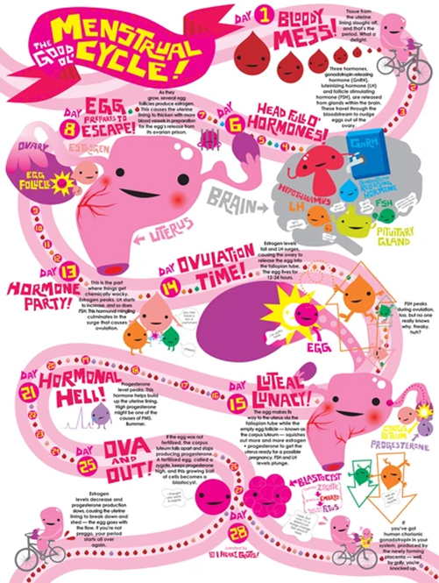
What is normal?

Slide 30
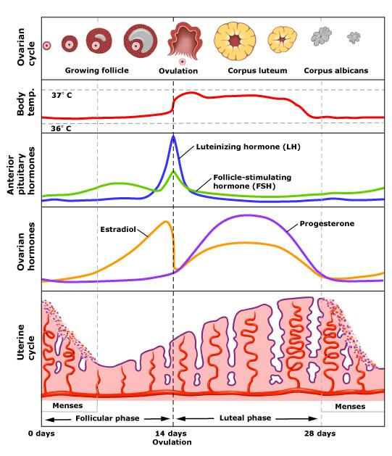
Notes:
The menstrual cycle is divided into 3 phases: follicular, ovulatory, and luteal.
Luteal: pulsatile GnRH from the hypothalamus stimulated secretion of FSH and LH form the pituitary. FSH increases the number of granulosa cells and FSH receptors, induces production of aromatase (converts androgens to estradiol which also had positive feedback on granulosa cells). LH stimulates theca cells to secrete androgens for conversion into estradiol.
By day 5-7 a dominant follicle emerges. Increasing levels of estradiol cause proliferation of the endometrium.
Ovulatory: Rising LH leads to follicular rupture and ovulation
Luteal: Formation of corpus luteum which secretes progesterone; endometrium becomes secretory (coiling of the endometrial glands, increased vascularity of stroma) Matures by 8-9 days then starts to regress. Drop in progesterone and estrogen causing endometrium to undergo necrotic changes and result in menstrual bleeding.

Slide 31
Menstrual Patterns in Adolescence
Normal Menstrual Cycles in Young Females
Menarche (median age) | 12.43
Mean cycle interval | 32.2 days
Menstrual cycle interval range | 21-45 days
Menstrual flow length | 7 days or less
Menstrual product use | 3-6 pads/tampons per day
Joint Committee Opinion ACOG and AAP November 2006, Reaffirmed 2009
Notes:
From the early 1800s to mid 1950s menarche ocurred at increasingly earlier ages in the US; no significant change since. Likely due to increasing BMI at earlier ages. One exception is non Hispanic black girls, average age of menarche is 5.5 months earlier than 30 years ago.

Slide 32
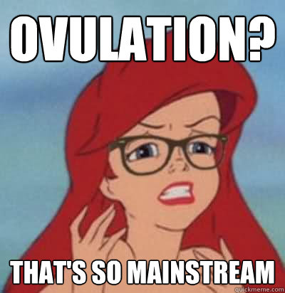
Adolescence & Cycle length
The early years
Anovulatory cycles are normal
21-45 days is most common
Earlier menarche = earlier ovulatory cycles
Fully ovulatory cycles may take 8-12 years
90% of girls have 27-35 day cycles by
7th gynecological year¹
¹WHO Task Force on Adolescent Reproductive Health. J Adolesc Health Care 1986

Slide 33
Menstruation in Girls and Adolescents: Using the Menstrual cycle as a Vital Sign
Menstruation in Girls and Adolescents: Using the Menstrual Cycle as a Vital Sign. AAP Committee on Adolescence. ACOG Committee on Adolescent Health Care. Pediatrics. 2006.

Slide 34
common causes of irregular menses
Pregnancy!
Anovulation secondary to immature HPO axis
Endocrine | Thyroid dysfunction PCOS Poorly controlled GM Cushing disease Premature ovarian insufficiency Congenital Adrenal Hyperplasia
Acquired conditions | Hypothalamic dysfunction related to stress Medications Female Athlete Triad Easing disorder
Tumors | Ovarian Adrenal Prolactinoma

Slide 35
Classification of Abnormal Bleeding
Abnormal uterine bleeding (AUB)
- Heavy menstrual bleeding (AUB/HMB)
- Intermenstrual bleeding (AUB/IMB)
PALM: Structural Causes
Polyp (AUB-P)
Adenomyosis (AUB-A)
Leiomyoma (AUB-L)
Malignancy/Hyperplasia (AUB-M)
COEIN: Nonstructural Causes
Coagulopathy (AUB-C)
Ovulatory Dysfunction (AUB-O)
Endometrial (AUB-E)
Iatrogenic (AUB-I)
Not yet classified (AUB-N)

Slide 37
Menses has not started 3 years after thelarche
Menses has not started by 13 with
Menses has not started by 14 with
Menses has not started by age 15
Signs of hirsutism
Concern for eating disorder/over exercising
Concern for outflow obstruction
Are regular, occurring monthly, and then become markedly irregular
Occur more frequently than every 21 days or less frequently than every 45 days
Occur 90 days apart even for one cycle
Last >7 days
Require frequent pad/tampon changes (soaking more than 1 every 1–2 hours)
No signs of puberty

Slide 38
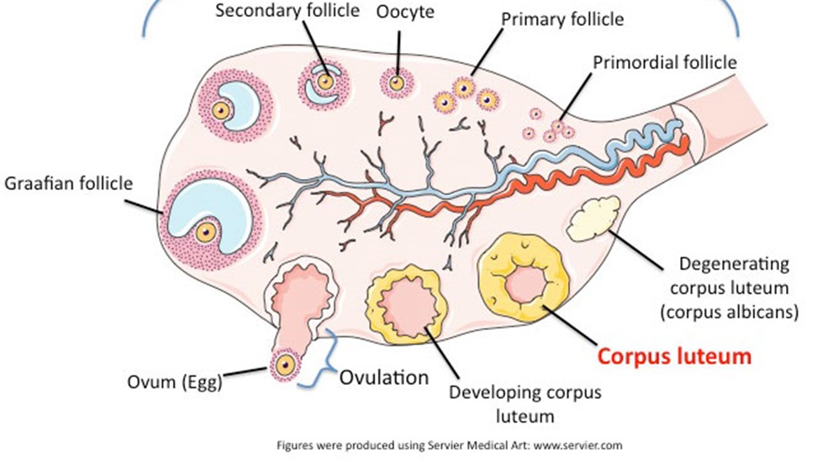
Problem #1: prolonged periods
Clinical Presentation
Pathophysiology
Recent menarche
Missed period(s)
Prolonged or excessively heavy bleeding episode
Absent ovulation = no corpus luteum
Progesterone not secreted
Endometrium proliferating by unopposed estrogen
Fragile, vascular proliferative endometrium sheds irregularly

Slide 39
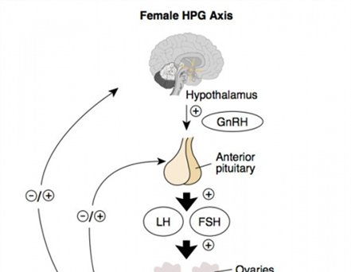
Immature HPO axis
Evaluation
Treatment
HCG
CBC/iron studies
TSH
Expectant Management
Acute bleeding episode
Provera 10mg x 10 days
Inhibits GnRH
Endometrium proliferative → secretory Bleeding occurs after 2-7 days
“Period Pills”
Combination OCPs vs Progesterone only
Anemia

Slide 40
Problem #2: PCOS
Clinical Presentation
Evaluation
Irregular or absent periods
Excess facial or body hair
> 2 years from menarche
FHx of PCOS is common
Laboratory evaluation for androgen abnormalities
HCG
TSH
Prolactin
Testosterone
Estradiol
FSH/LH
Strong suspicion for PCOS
17-Hydroxyprogesterone
DHEA-S
HbA1C
Lipid panel

Slide 41
Polycystic ovarian syndrome Functional Ovarian Hyperandrogensim Androgen excess Syndrome
Controversial diagnosis in adolescents
Likely different phenotypes
Androgen Excess Society diagnostic criteria
Clinical or serum hyperandrogenism
Ovulatory dysfunction (irregular periods)
Importance of diagnosis & treatment
Protection of endometrium
Management of irregular menses
Reduction in hirsutism and acne
Decrease risk of diabetes
Reduce cardiovascular risks

Slide 42
Pcos treatment

Slide 43
PCOS Treatment
Hormonal
Nonhormonal
Combination estrogen/progestin OCPs
30mcg ethynyl estradiol
Regulate menses
Protects endometrium
Decreases adrenal androgen secretion
Increases SHBG
Progestin only therapy
Provera withdrawal bleed q 2-3 months
Progesterone only pill
Contraindication to estrogen
Levonorgesterol Intrauterine Device
Endometrial protection
Metformin
Often requires higher doses to affect menstruation
May help with weight loss
Indicated for prediabetes
Spironolactone
Aldosterone antagonist
Teratogenic

Slide 44
Problem #3: heavy menstrual bleeding
Clinical Presentation
Evaluation
Regular menses
Duration > 7 days
Flow outside of normal parameters
Changes products every 1-2 hrs
Passing clots larger than a quarter
Anemia or history of anemia
+ screen for blood diathesis
Heme
CBC
Ferritin
PT/PTT
VWD Panel
Fibrinogen
Thrombin Time
Platelet aggregation studies*
Endo
HCG
TFTs
PRL
Ultrasound should not be part of first tier testing in adolescents
Most causes of HMB are non-structural

Slide 45
Treatment of acute hmb
COCs | COC Taper | Progesterone Only | Progesterone Only
Flow is light | Flow is heavy | Flow is light | Flow is heavy
30 mcg pill (Cryselle) | 30mcg pill (Cryselle) | Provera 10-20mg Or Aygestin 5mg | Provera 20mg Or Aygestin 5mg
1 tablet daily | 1 tab TID x 3 days 1 tab BID x2 weeks 1 tab Qday | 1 tablet daily | 1 tab TID x 7 days 1 tab BID x 7 days 1 tab Qday

Slide 46
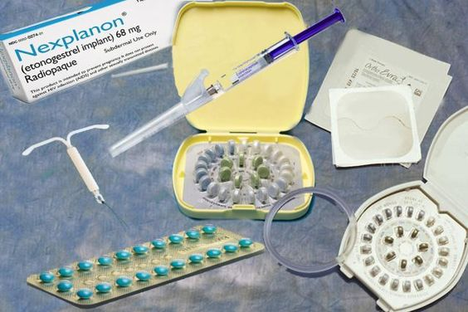
Treatment of chronic heavy menses
Combination pills
Progesterone only pills
Patch
Vaginal Ring
Depo Provera
Nexplanon
Intrauterine Device

Slide 47
Part 3: period progress (and preventing pregnancy)

Slide 48
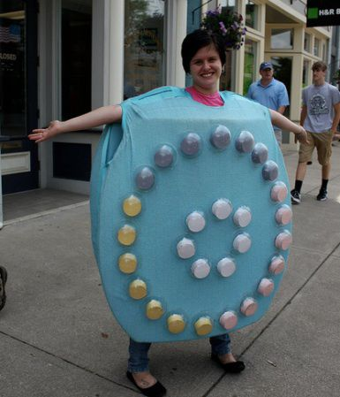

Slide 49
OCPs are (relatively) safe!
Contraindications
Combination
OCPs
Clotting disorders
History of DVT/PE
Migraine with aura or focal neurological deficit
Hypertension/vascular disease
Progesterone Only
OCPs

Slide 50
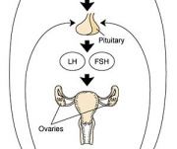
Mechanism of Action: Combination OCPs
Thickens cervical mucus
Suppresses ovulation via negative feedback
Decreased GnRH pulsatility
Decreased pituitary responsiveness
Suppression of LH and FSH
Inhibits mid-cycle LH surge
Decreased tubal motility
Endometrial atrophy and localized edema

Slide 51
Combination OCPs: Advantages
General | Menstrual | Health
Efficacy* | ↓ Dysmenorrhea | ↓ Ovarian cancer
Safety | ↓ Blood loss | ↓ Endometrial cancer
Reversibility | ↓ PMS | Acne & hirsutism
Side effects | ↓ Anovulatory bleeding | ↓ Endometriosis pain
 | ↓ Ovarian cysts | ↓ Benign breast disease
Notes:
Efficacy
when taken correctly 0.3% failure
Real world efficacy 8% failure/pregnancy
When used correctly and consistently, the failure rate for combined oral contraceptive pills is <1%, but, because the pill requires daily maintenance, efficacy rates for typical use are approximately 3% in adults.[i] Failure rates in adolescents range from 5%–25%, mainly due to noncompliance.[ii] Research indicates that 33% of adolescents are adherent after one year of use (i.e. 2/3 are not).[ii]
Safety
COCs are safer than pregnancy and delivery!
Reversability
~ 2 week
Side effect
Nausea
Headache
Breast tenderness
Hypertension
Effect on Ovarian Cancer
Women who use COCs are 34% less likely to develop epithelial ovarian CA
Use of monophasic formulations for >10years reduces woman’s risk of epithelial ovarian CA by 80%
Protection lasts for up to 20years after COC discontinuation
1st degree relative with ovarian CA, COC use for 4yrs = 90% risk reduction
Unclear risk reduction for BRCA mutation-carriers
Effects on the Breast
Estrogen causes hypertrophy of breast adipose cells, ~ 30% of women experience mastalgia with COC initiation
High dose (EE 50mcg) formulations associated with slight increase in breast CA
No increased risk of breast CA with low-dose EE
Decreased risk of benign breast conditions
Fibrocystic breast changes, cysts, fibroadenoma
No effect on hyperplasia with atypia

Slide 52
What is in them?
Progesterone
1st generation: Norethindrone
2nd generation: Levonorgestrel
More androgenic
3rd generation: Desonorgestrel
Least androgenic
4th Generation: Drosperinone
Anti-androgenic properties
Irregular spotting
Estrogen
Ethinyl estradiol
20-50 micrograms
>35 micrograms rare
Notes:
1st generation – tolerated well, low dose may have more spotting
2dn genration – more potent, longer half life (used for IUD); more androgenic (libido, acne hirsutism)
3rd generation - reduced androgenic activity (better for acne)
4th generation – also anti-androgenic activity (?increase in VTE)
In combined pills, ethinyl estradiol (EE) is most commonly the estrogenic compound with doses ranging from 20 to 50 mcg per pill, though few of the newer pills contain more than 35 mcg of estrogen. There are eight types of progestins used in COCs that are classified by pharmacology and generation.
The estrane family, also called first generation progestins, includes norethindrone, norethindrone acetate, and ethynodiol diacetate. The gonane family consists of second and third generation progestins. The second generation progestins include levonorgestrel and norgestrel and possess varying degrees of androgenic and estrogenic properties. The third generation progestins have the least androgenic effects and include desogestrel and norgestimate. Drospirenone is a fourth generation progestin. Unlike the others, this progestin is derived from 17α-spirolactione, not from 19-nortetosterone.
In May 2001, the FDA approved the first COC to utilize the fourth generation progestin drospirenone (Yasmin 28®, Berlex Laboratories). This is a monphasic formulation containing 30 mcg of ethinyl estradiol 3 mg of drospirenone. A little over five years later, the FDA approved a contraceptive pill (Yaz®, Bayer Healthcare Pharmaceuticals) containing 20 mcg ethinyl estradiol and 3 mg drospierenone. Yaz® includes 24 active pills and only 4 placebo pills to offer patients fewer hormonal fluctuations. This drug regimen has also been FDA approved for treatment of premenstrual dysphoric disorder (PMDD) and acne. The advantage of having 24 days of active pills and 3 days of placebo is to decrease the number of days for menses and alleviate symptoms associated with premenstrual syndrome. This method may also decrease symptoms related to estrogen withdrawal (such as headaches) during the place phase of the 28-day regimen.

Slide 53
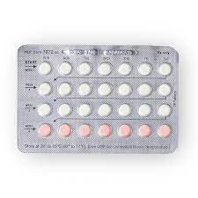
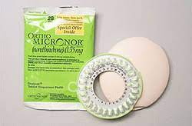
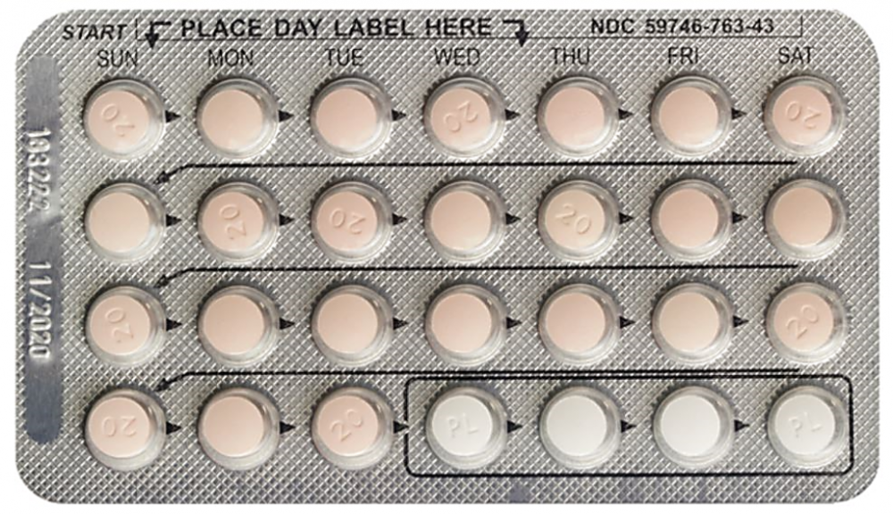
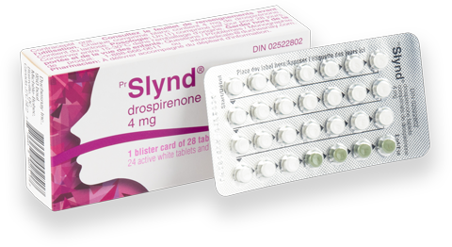
Combination OCPs
My “go to” pills
Junel 1/20
Cryselle 300/30
Progesterone Only Pills
Ortho Micronor
Slynd

Slide 54
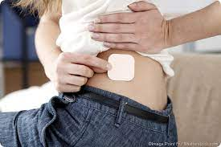
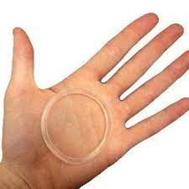
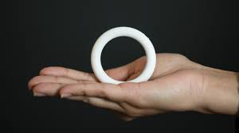
Ortho Evra Patch
(weekly)
NuvaRing
(monthly)
Annovera
(yearly)

Slide 55
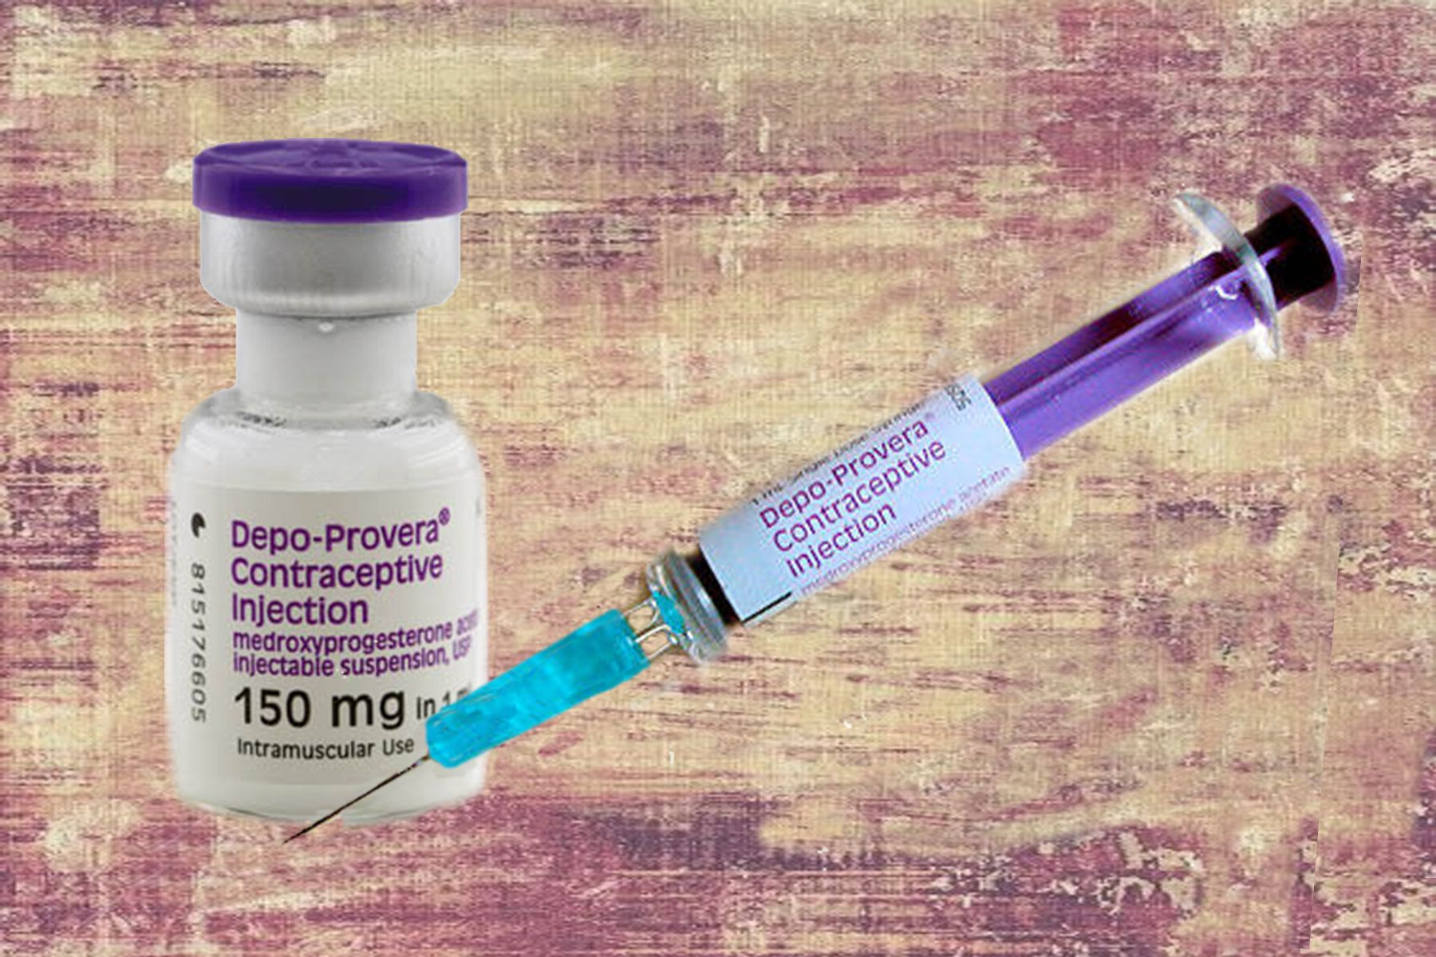
DMPA: Depo Provera
High rates of amenorrhea by the 4th dose
90% per 90 day cycle
Every 3 month administration
Option for SQ home administration
Lower risk of VTE

Slide 56
DMPA: BMD and Fracture Risk
Decreased bone mineral density
Adequate recovery after discontinuation
Several studies do not indicate increased fracture risk
Routine BMD scanning is not recommended
Potential health risks must be balanced against excessive menstruation and/or unintended pregnancy

Slide 57
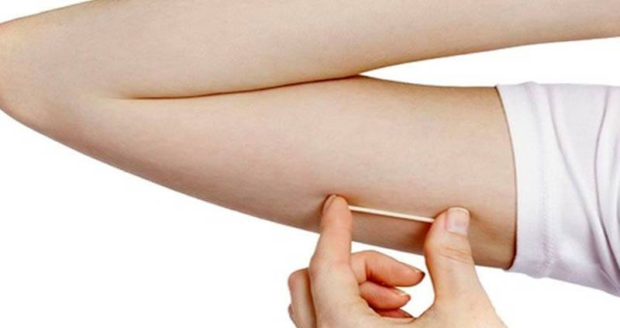
Contraceptive Implant
Large decrease in dysmenorrhea
Extremely reliable contraceptive
High incidence of unscheduled and prolonged bleeding (up to 40%)
Approximately 20% achieve amenorrhea
More than 10% request removal

Slide 58
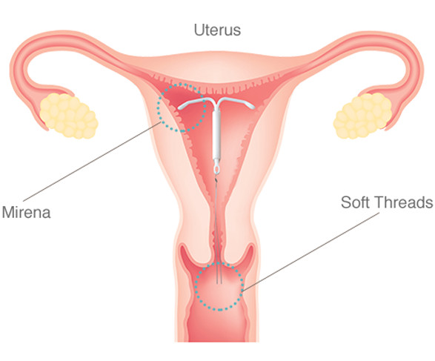
Levonorgestrel IUD
Irregular bleeding initially is common
Amenorrhea rates increase over time
Overall blood loss is decreased significantly
Mirena – 24 mcg/day
FDA approved for 8 years
Kyleena - 17.5mcg/day
FDA approved for 5 years

Slide 59
U.S. Medical Eligibility Criteria for Contraceptive Use, 2016
Risk Category
1 = no restriction for the use of the contraceptive method
2 = advantages of method generally outweigh the theoretical or proven risks
3 = theoretical or proven risks generally outweigh the advantages
4 = unacceptable health risk if the contraceptive is used
World Health Organization. Medical Eligibility Criteria for Contraceptive Use. 2016.
Notes:
(TAKE TIME WITH THIS SLIDE)
ACOG (American College of Obstetricians and Gynecologists) and WHO state that migraine with aura is an absolute contraindication to the use of estrogen-containing combined hormonal contraception.
1 = A condition for which there is no restriction for the use of the contraceptive method (non-migraine HA)
2 = A condition where the advantages of using the method generally outweigh the theoretical or proven risks (Migraine without aura age <35y, nonsmoker; Non-migraine HA develop after initiation)
3 = A condition where the theoretical or proven risks generally outweigh the advantages (Migraine without aura, age >35y; Migraine without aura develop after initiation)
4 = A condition which represents an unacceptable health risk if the contraceptive is used (Migraines with aura, any age; Migraines with aura develop after initiation
IHS Task Force on Combined Oral Contraceptives and Hormone Replacement Therapy guidelines are slightly more liberal and advocate individualized risk assessment. IHS suggests that other independent risk factors for stroke also be assessed and taken into consideration, including age > 35 years, tobacco use, dyslipidemia, family history of arterial disease, and other relevant medical comorbidities (ie, obesity, diabetes, known vascular disease).

Slide 60
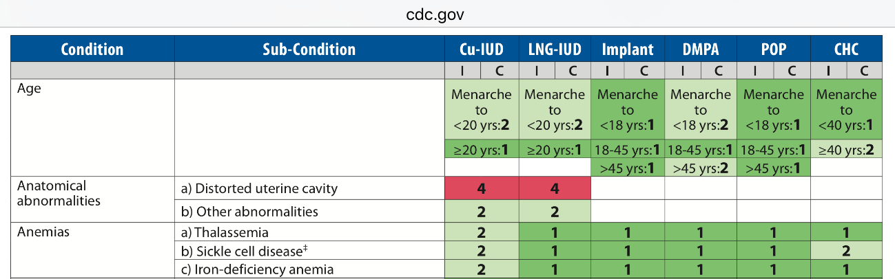

Slide 61
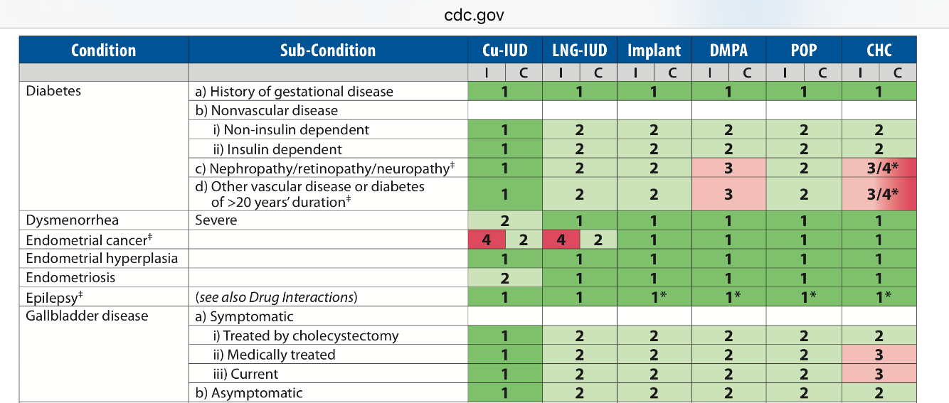

Slide 62
Long-acting reversible contraception is recommended

Slide 63
Breaking news

Slide 64
PAGE Clinic pediatric adolescent gynecology & endocrine clinic
Polycystic ovarian syndrome
Primary ovarian insufficiency
Complex amenorrhea
Dr. Rachel Casey
Maureen Harris, RD
Dr. Lindsay Waldman

Slide 65
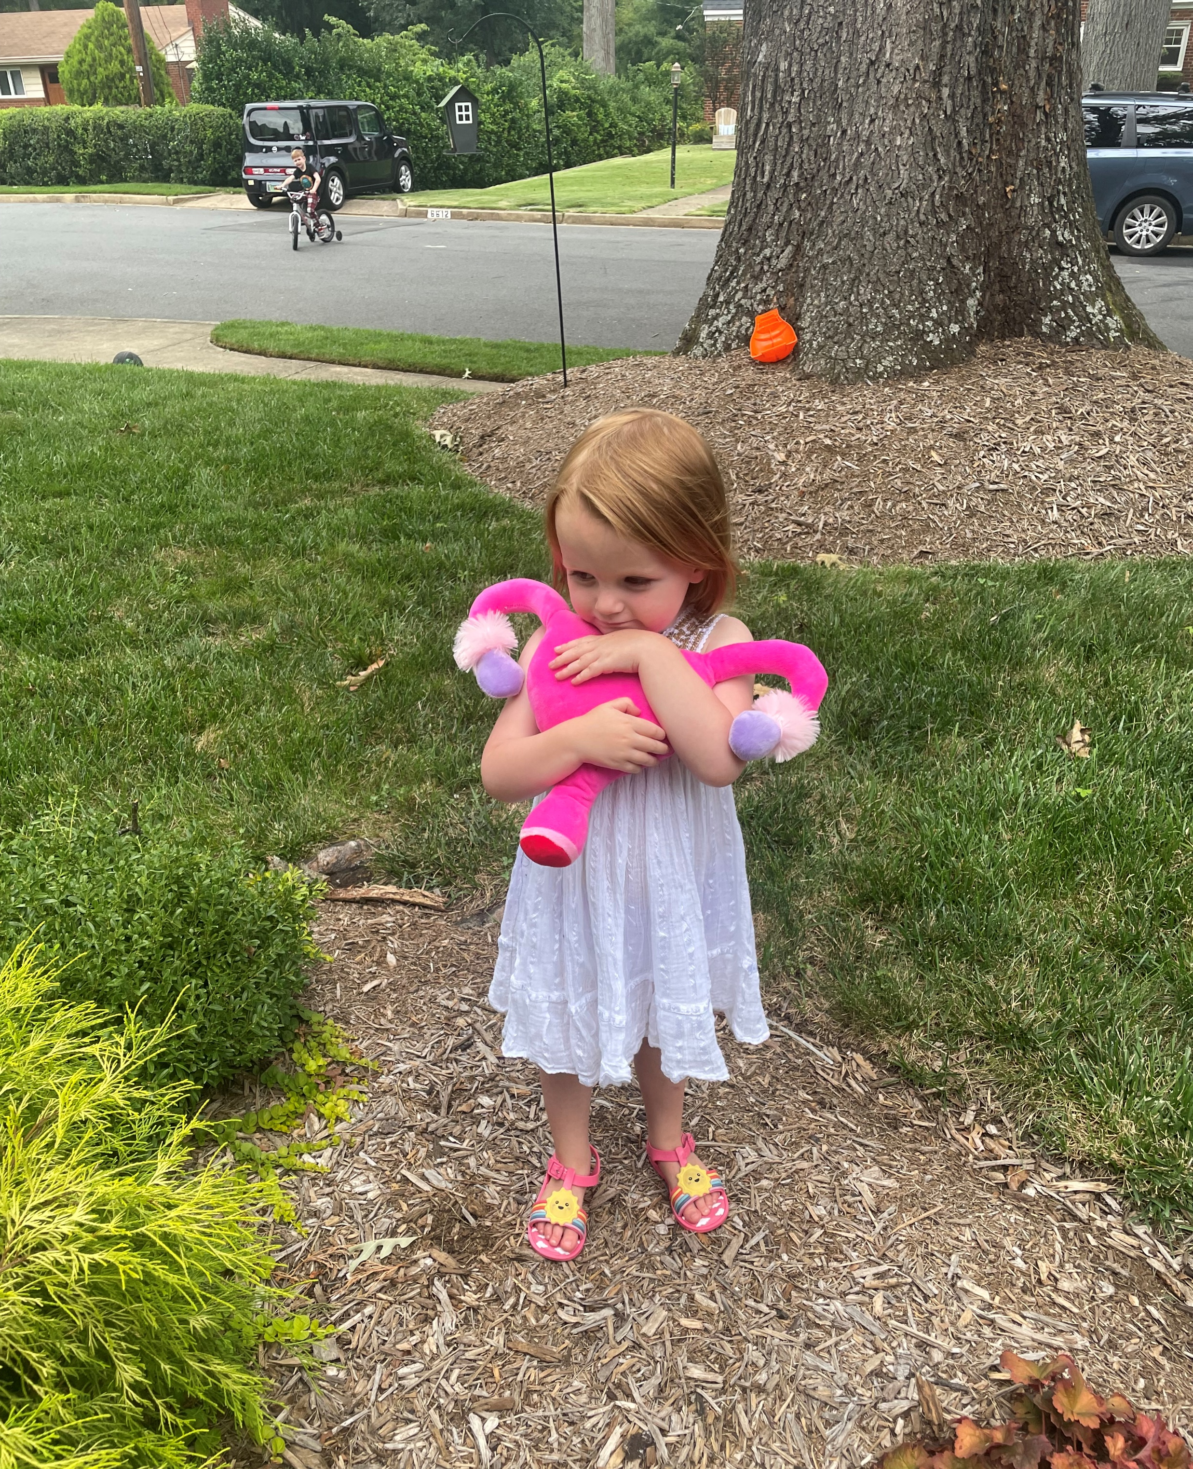
Thank you!

