Slide 1
Helping Us Help You:
Optimizing Pediatric Imaging
Nakul Jerath, MD, MPH, FAAP

Slide 2
Helping Us Help You:
Optimizing Pediatric Imaging
Nakul Jerath, MD, MPH, FAAP
no disclosures

Slide 3
Fairfax Radiological Consultants
90 subspecialized radiologists
Provide services to Inova Fairfax, Inova Fair Oaks and Inova Loudoun Hospitals and satellites
Own/operate 20 outpatient offices in joint venture with Inova, as well as Fairfax Vascular Center
Operate Inova Fairfax MRI Center at Center for Personalized Health

Slide 4
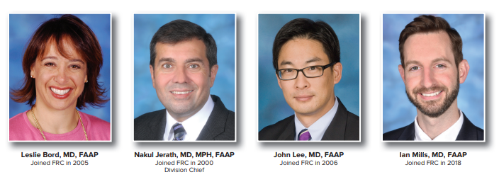
Who We Are

Slide 5
Who We Are
4 fellowship trained pediatric radiologists
Available 7 days a week at Inova Children’s Hospital
M-F 8A-11P
Sat/Sun/Holidays 8A-5P
On call via overnight radiologist
Provide interpretation for exams at Inova and FRC offices

Slide 6
What We Do
Provide body imaging services for neonates, infants, children and adolescents up to age 21
Read Xrays, CT, MR
Perform and Read fluoroscopy and ultrasound
Protocol exams
Consult with clinicians
703-776-3262

Slide 7
Our Commitment
FRC accepts Inova Charity patients and follows their policy
FRC also has its own charity approval process for those who have not completed the Inova application
Questions: Kim Masters, COO, FRC

Slide 8
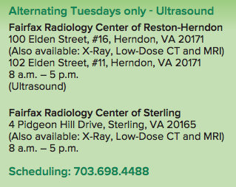
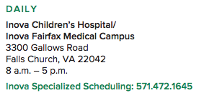

Slide 9
What’s great about imaging children

Slide 10
What’s great about imaging children
is the same as what’s great about all pediatric care

Slide 11
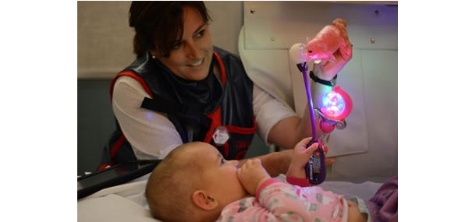
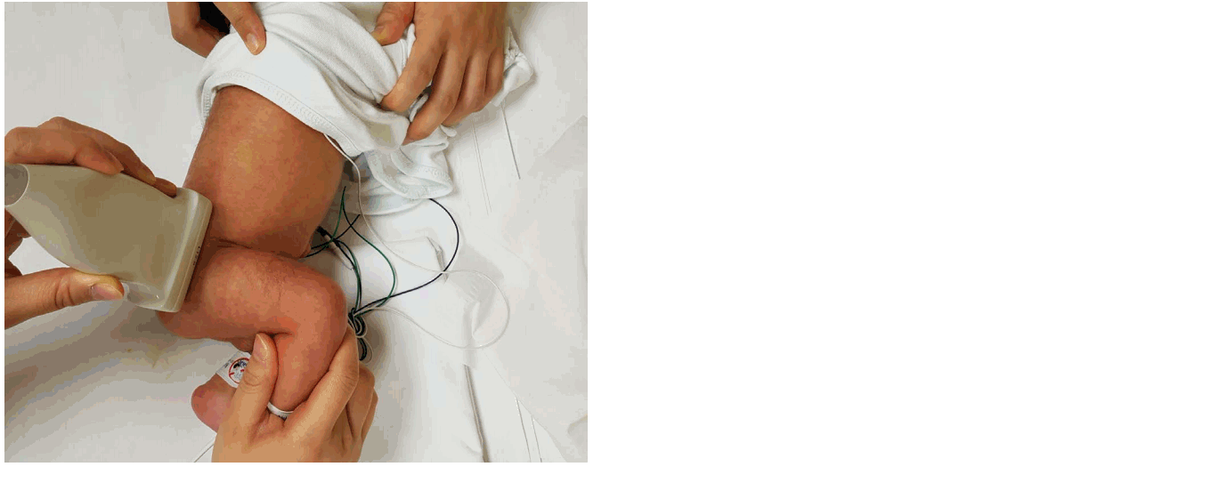

Slide 12
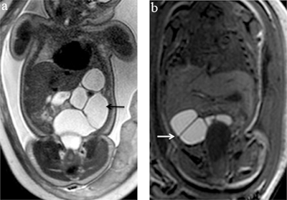
From Fetal Imaging

Slide 13
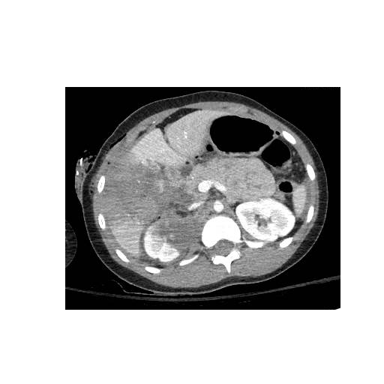
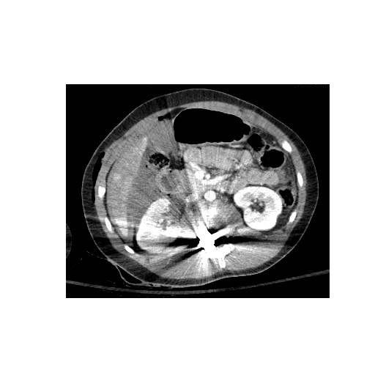
To Adolescents

Slide 14
Including procedures

Slide 15
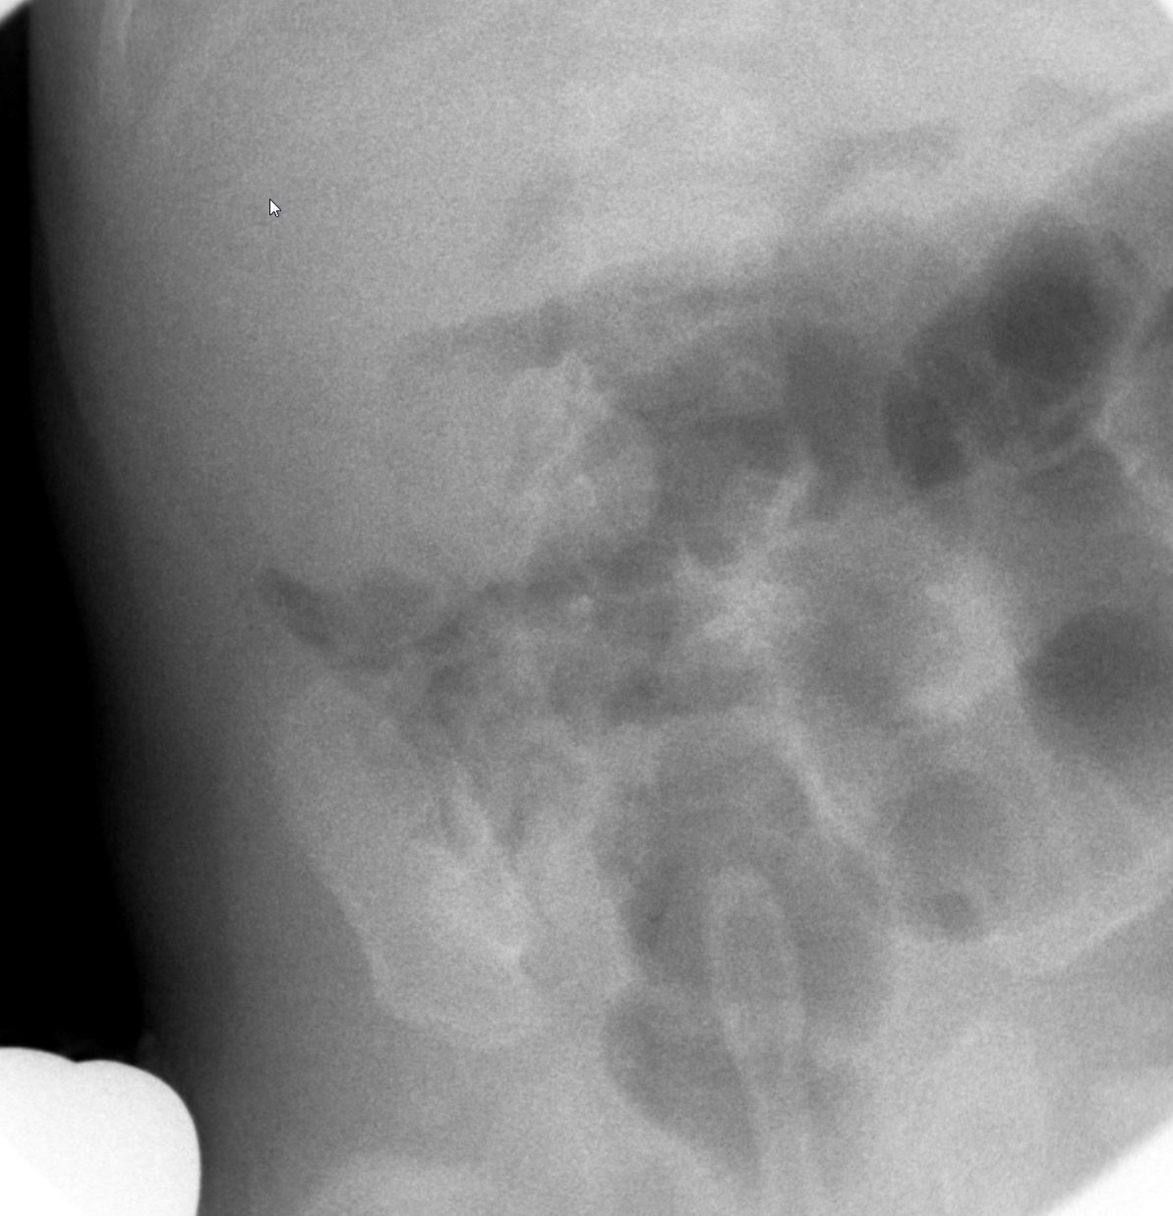

Slide 16
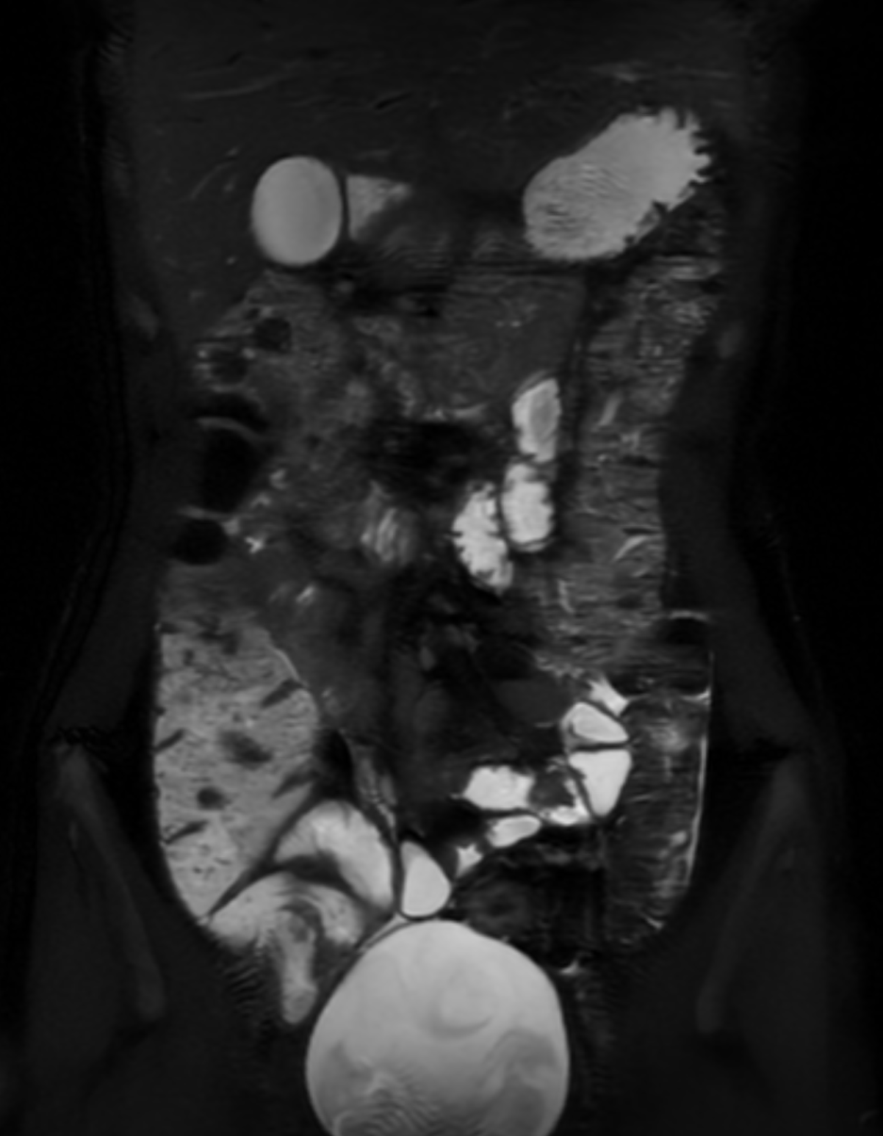
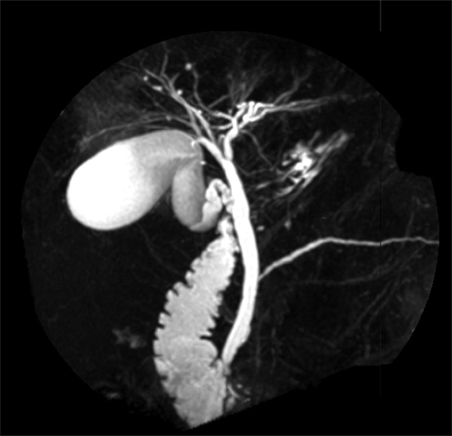
Amazing technology
MRCP
MRE

Slide 17
What Other Radiologists
Do For Children
Nuclear Medicine
Brain/Spine CT or MR
Vascular and non-vascular interventions
High end cardiac and musculoskeletal exams

Slide 18
Where to begin: Patient History
Please give relevant, current and appropriate history
What made you worry?

Slide 19
Abdominal Xray (single view)
Evaluate stool burden

Slide 20
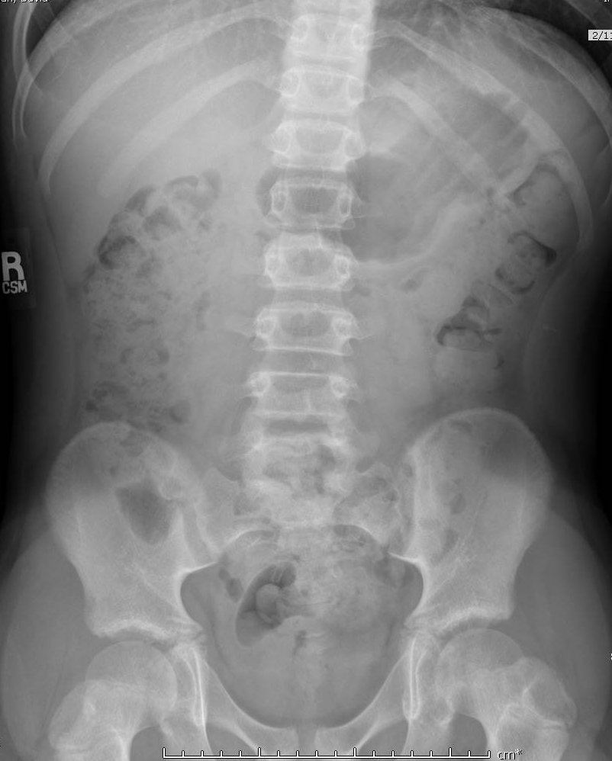

Slide 21
Abdominal Xray (single view)
Evaluate stool burden
Much prefer…
No stool in 5 days
Encopresis
Abdominal Pain
Palpable abnormality LLQ
Constipation post cleanout
Post op Hirschsprung

Slide 22
Abdominal Xray (two views)
Bowel obstruction
Pneumoperitoneum

Slide 23
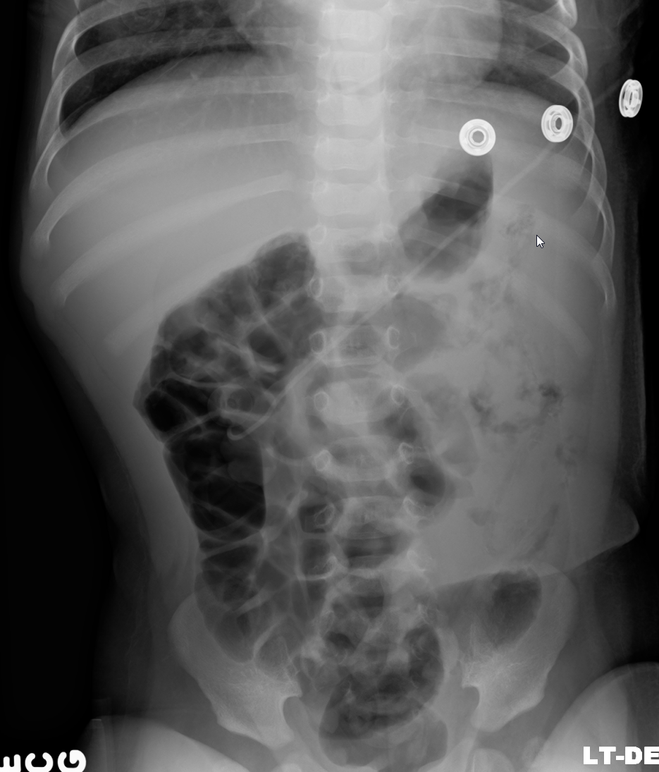
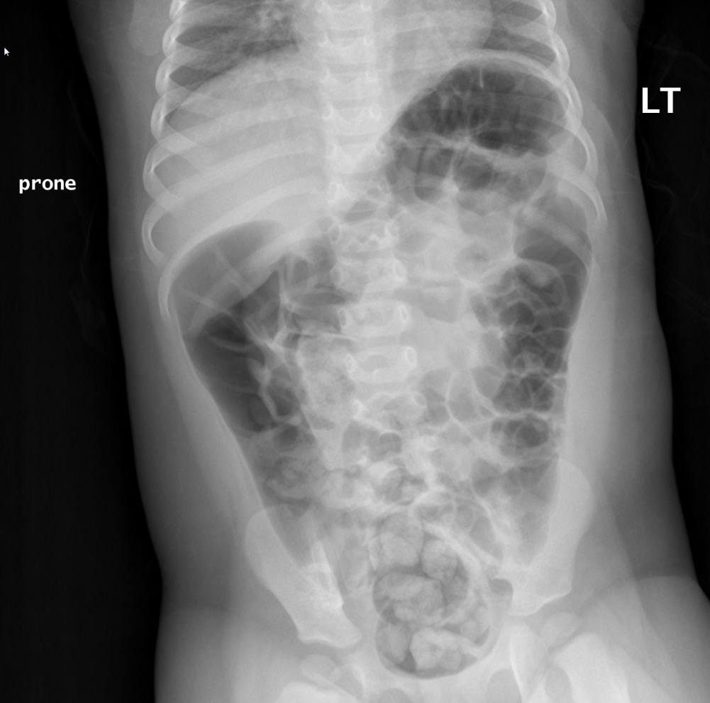

Slide 24
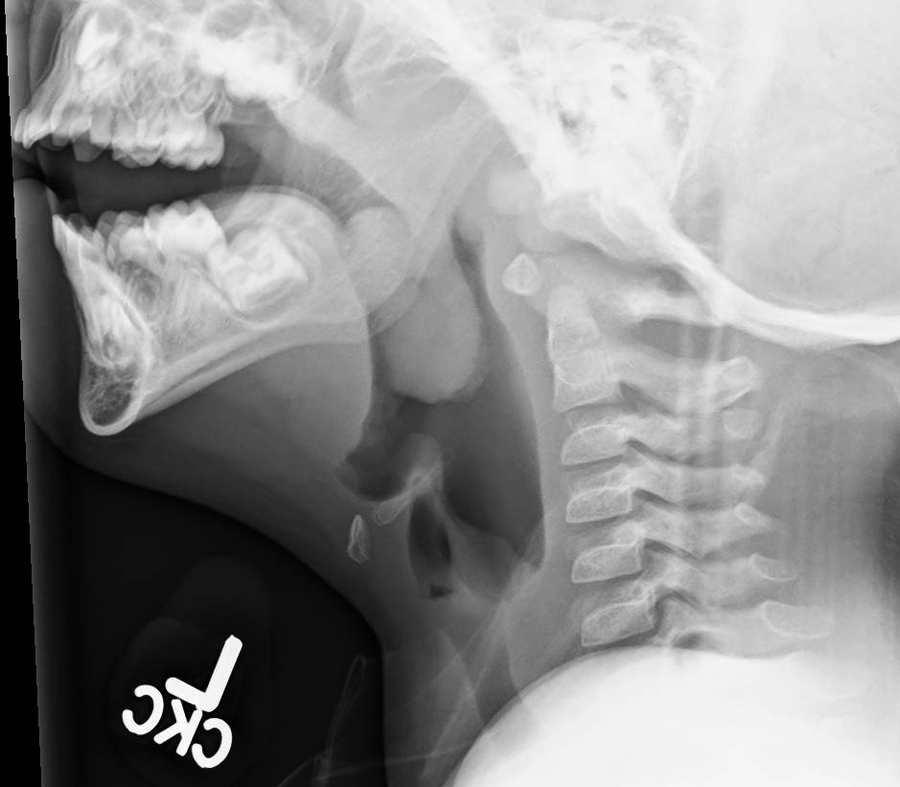
Lateral Neck
R/O Adenoids
Much prefer…
Mouth breather
Snoring
Apnea
Post op

Slide 25
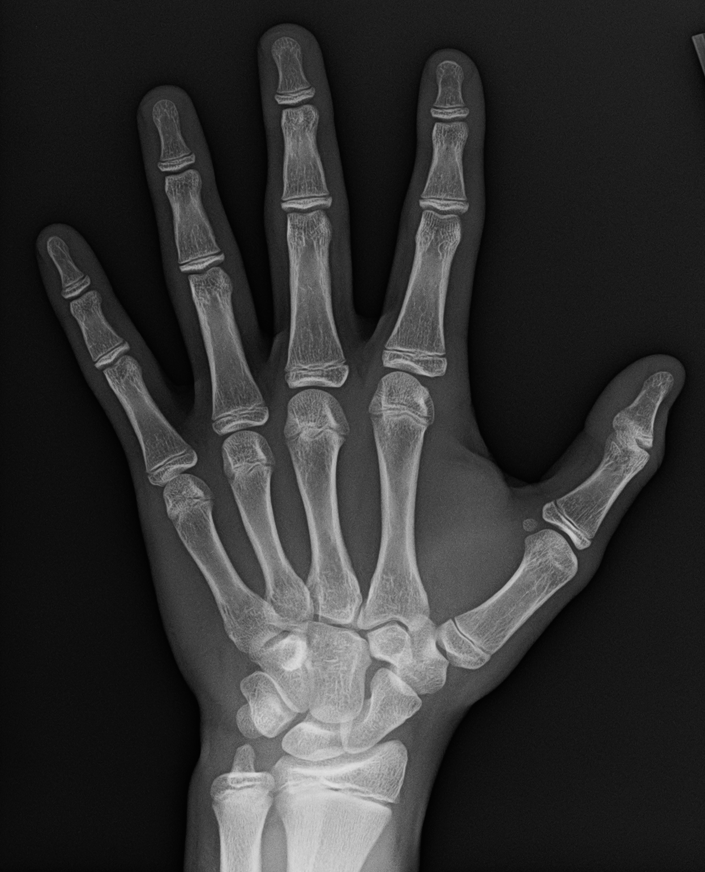
Bone Age
Assess growth
Much prefer…
Short stature
Premature thelarche
Growth arrest
GH deficiency
Hypothyroidism
Turner’s syndrome

Slide 26
Palpable Abnormality
Indicate area of concern
Ask for BB markers
Chest wall: Xray and targeted US

Slide 27
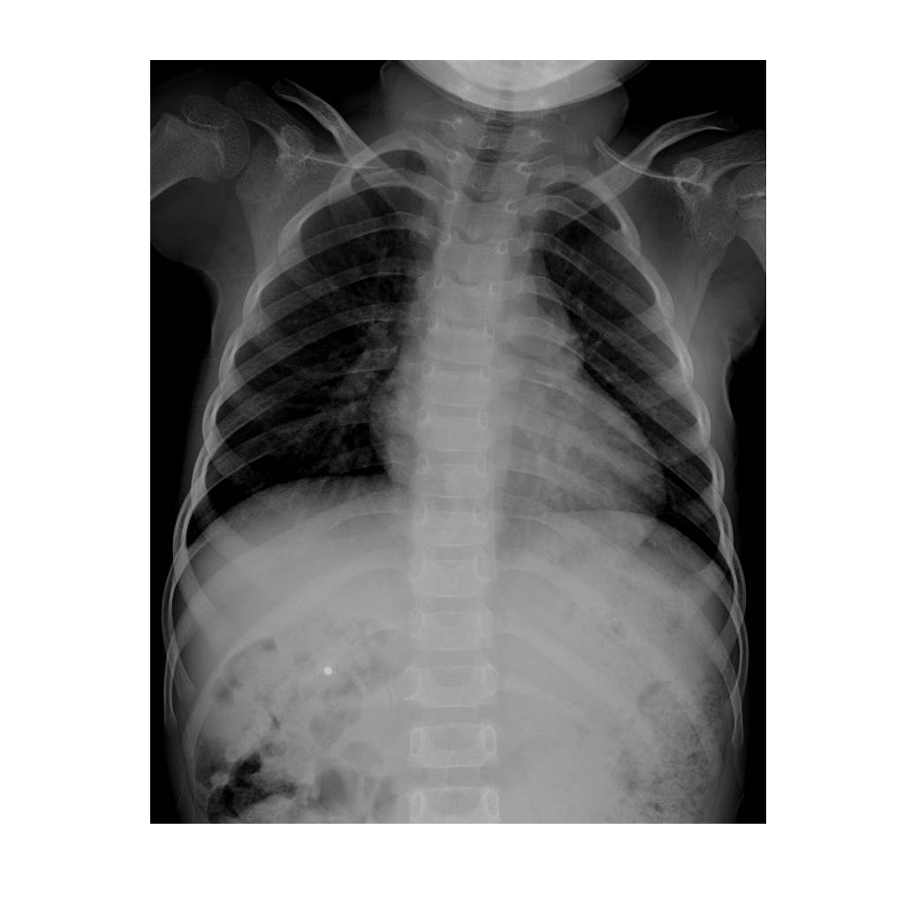

Slide 28
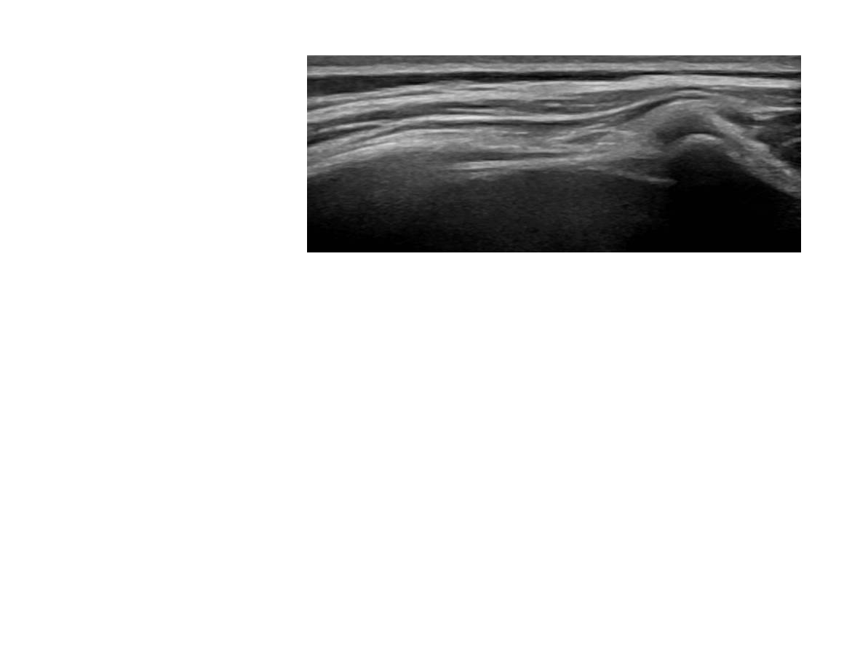

Slide 29
Give us the finger
Hand examination may not get true lateral of finger or thumb

Slide 30
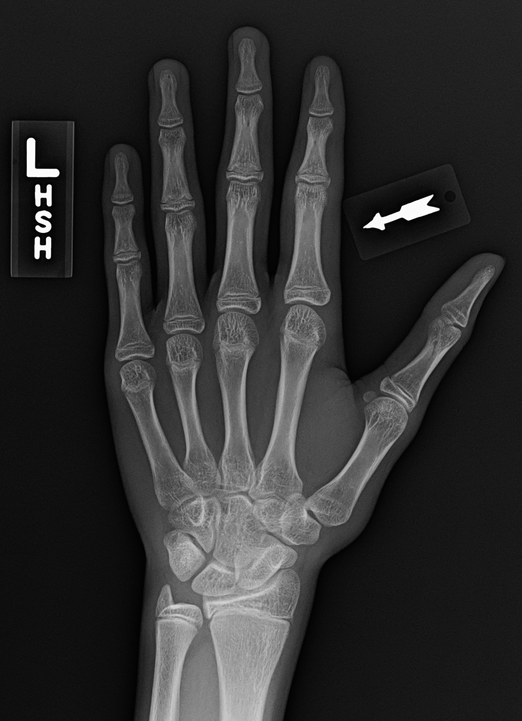
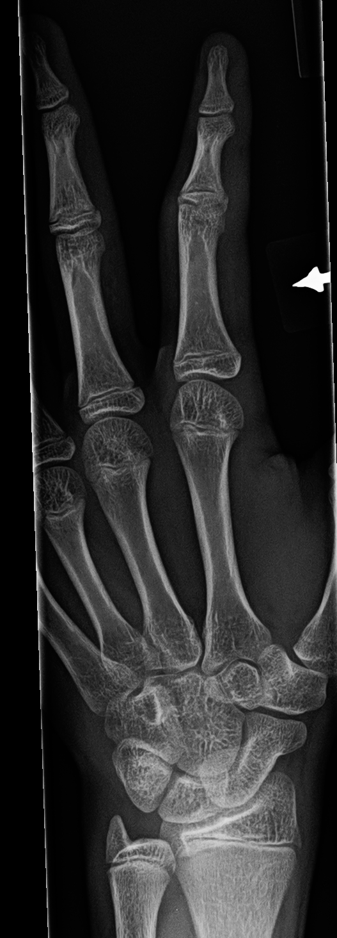
Give us the finger

Slide 31
Appropriate Ordering
Screening Exams
Emergencies
Preps
Infectious workup

Slide 32
Screening Exams
Emergencies
Preps
Infectious workup

Slide 33
Screening Exams
Otherwise healthy patient population
Non-invasive
Widely available
Low/reasonable cost
High negative predictive value
Ability to intervene on positive findings

Slide 34
Screening Exams & Indications
Renal US for Antenatal Hydronephrosis
Spine US for Sacral Dimple
Hip US for Dysplasia
Head US for Macrocephaly

Slide 35
Renal US for Antenatal Hydronephrosis
Physiologic dehydration
Greater than or equal to birth weight
Generally 2 weeks of age

Slide 36
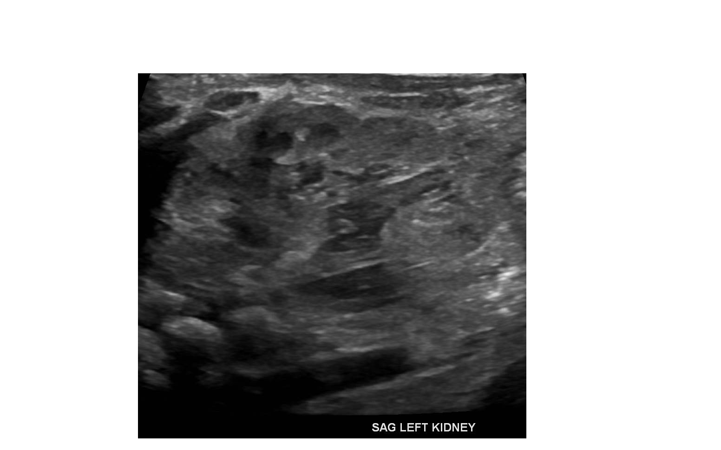
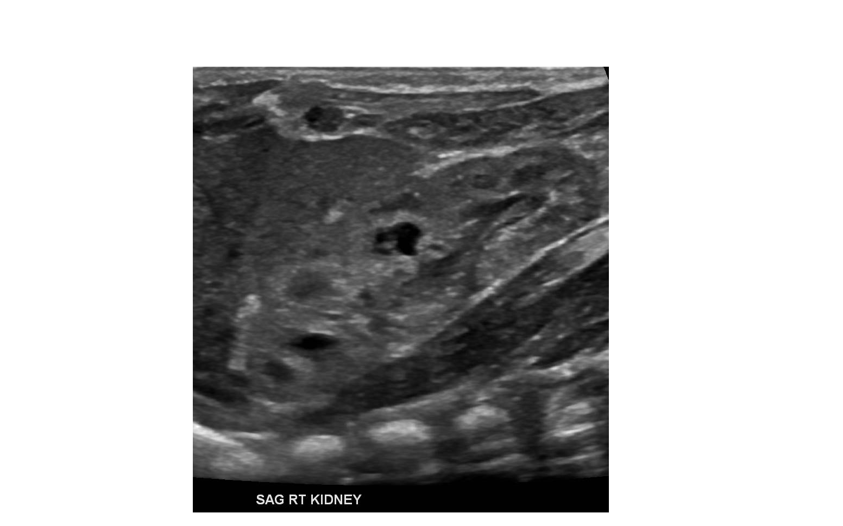
2 day old

Slide 37
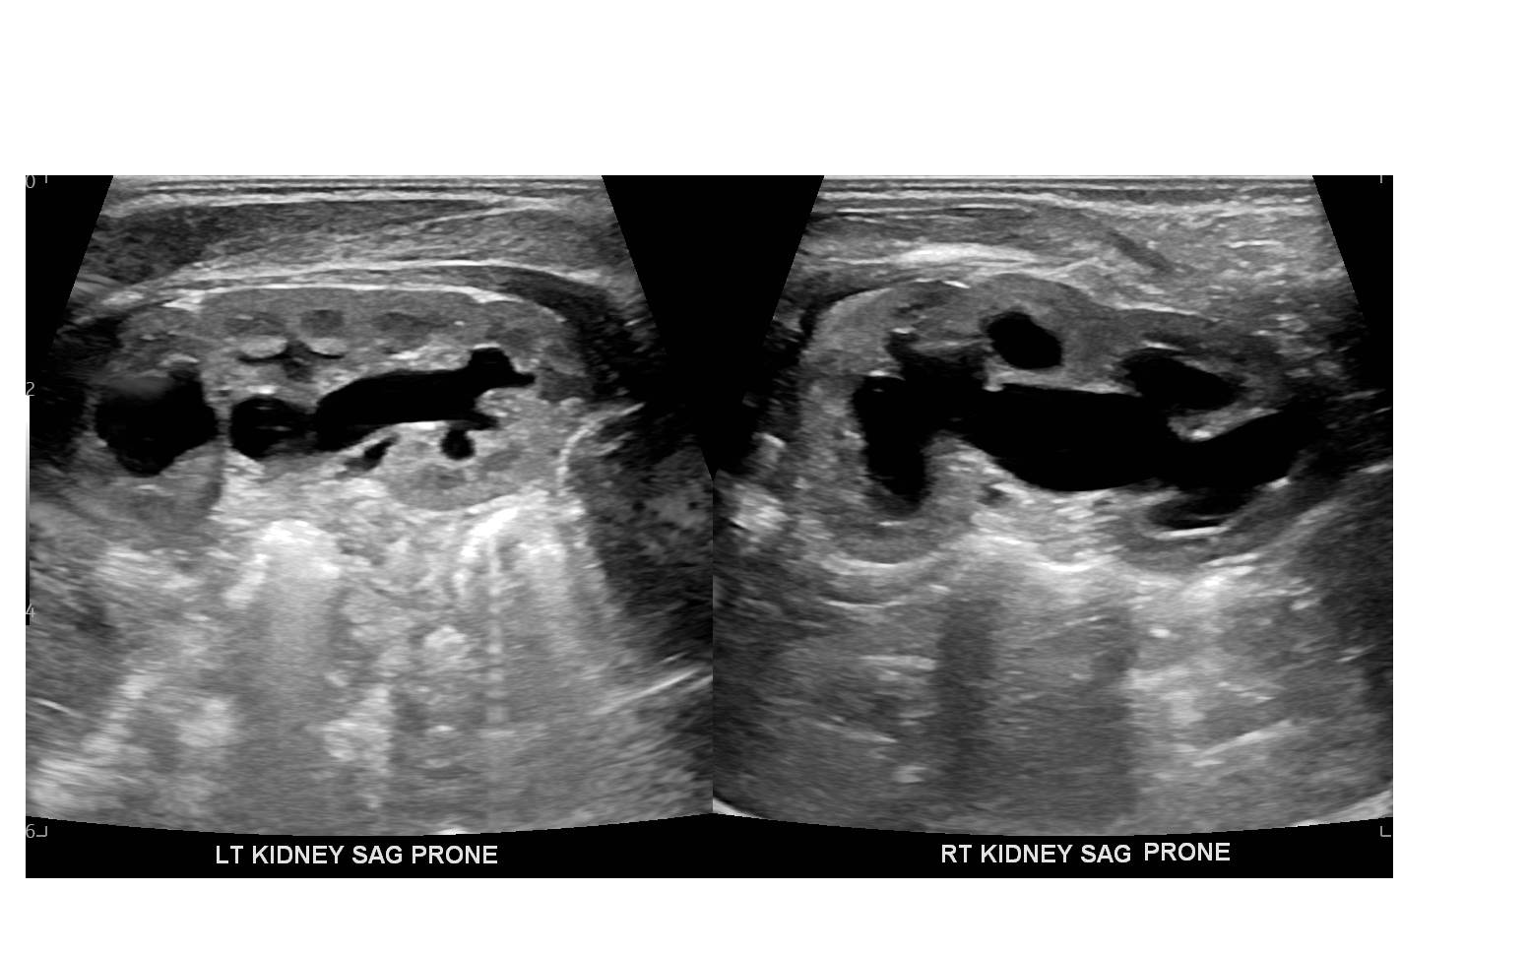
1 month old

Slide 38
Renal US for Antenatal Hydronephrosis
Physiologic dehydration
Greater than or equal to birthweight
Generally 2 weeks of age
Immediate post natal imaging: anuria (males -> PUV)
VACTERL, Oto-renal associations: can be imaged any time

Slide 39
Spine US for Sacral Dimple
Immediate perinatal period
Up to 6 weeks of age

Slide 40
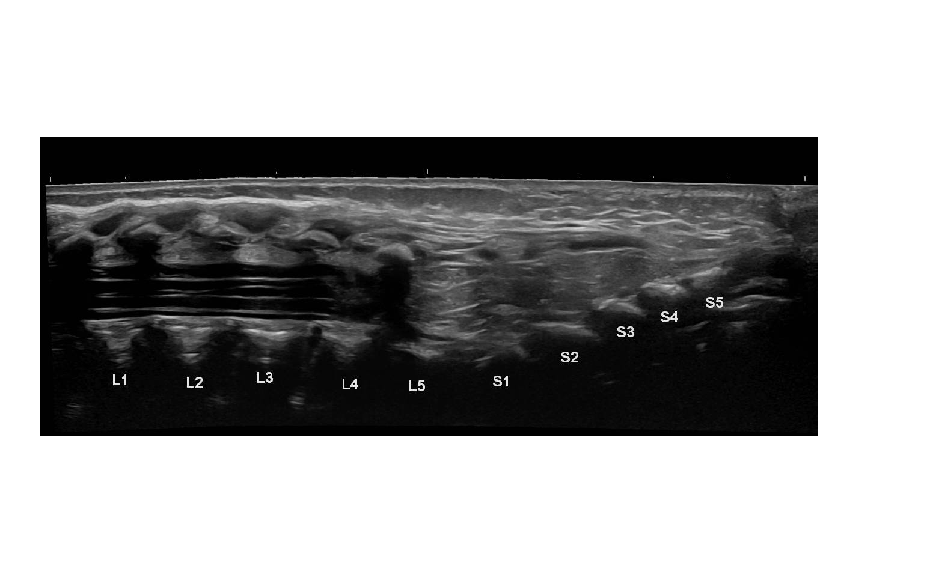
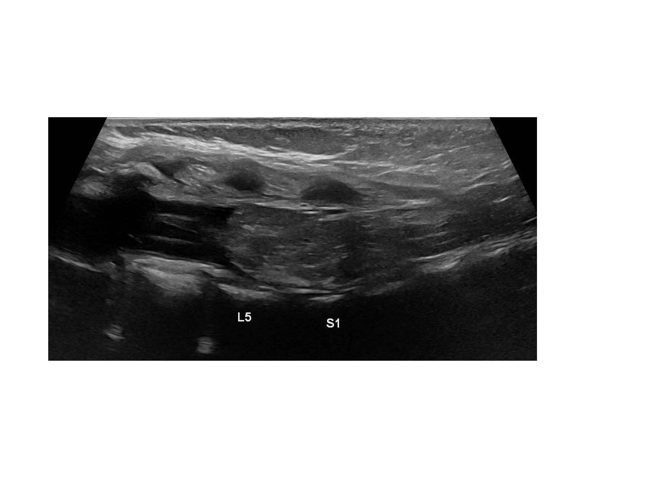

Slide 41
Spine US for Sacral Dimple
Immediate perinatal period
Up to 6 weeks of age
If done before hospital discharge and abnormal, can attempt “swaddle and scan” MRI

Slide 42
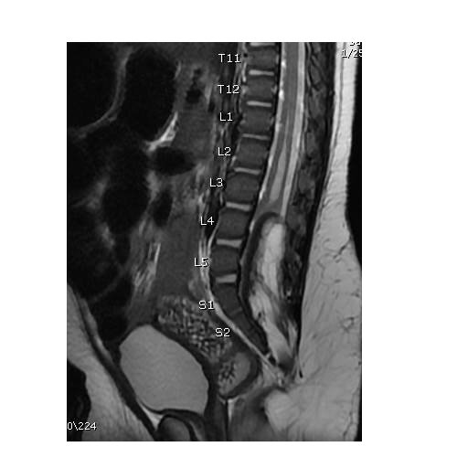

Slide 43
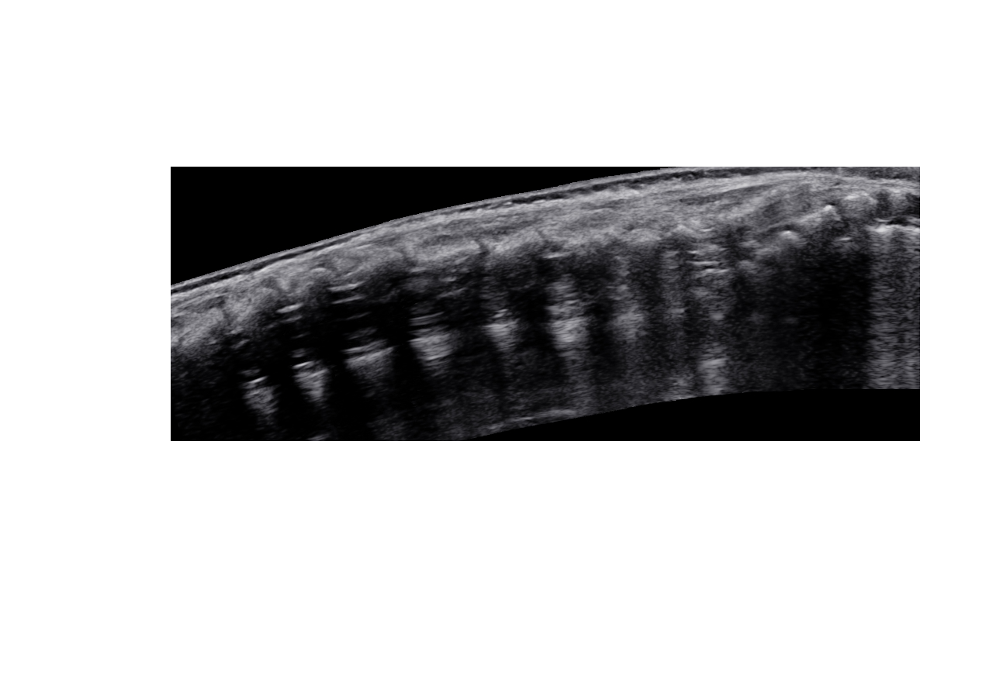
Newborn vs. 2 month old

Slide 44
Sacral Dimple
Immediate perinatal period
Up to 6 weeks of age
Midline, visible base, < 2.5 cm from anus?

Slide 45
Hip US for Dysplasia
Neonatal laxity
=> 2 weeks of age to 4-6 months
Older patients -> Xrays

Slide 46
Hip US for Dysplasia
Neonatal laxity
=> 2 weeks of age to 4-6 months
Older patients -> Xrays
Indications:
Breech presentation
Abnormal exam (Hip click/clunk)
Family History
Asymmetric buttock (not thigh) folds

Slide 48
Hip Dysplasia - New Guidance
Delayed Xrays in high risk patients
First degree relatives with dysplasia
Pelvis and frog leg lateral images
Even if initial ultrasound is normal
At 6-9 months of age

Slide 49
Head US for Macrocephaly
Palpable anterior fontanelle may not be enough
Fibrous/cartilaginous changes limits evaluation after 4 months
CT in patients => 6 months

Slide 50
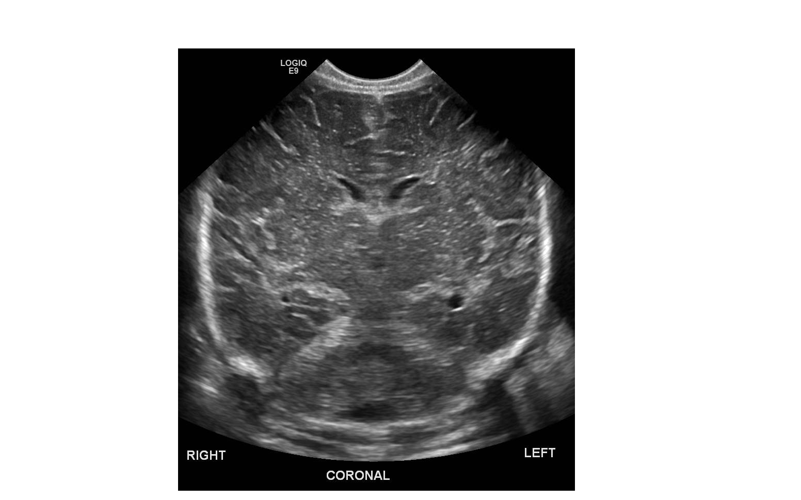
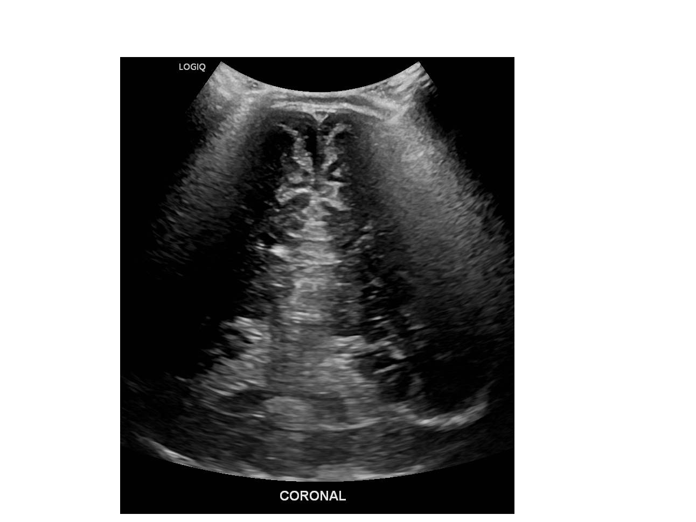
Newborn 6 month old

Slide 51
Screening Exams
Emergencies
Preps
Infectious workup

Slide 52
Emergencies
Do not stop at Starbucks
Critical Ingestion
Appendicitis
Gonadal torsion
Infantile bilious emesis

Slide 53
Critical Ingestion
Magnets and Batteries
Radiographic Protocol
Early intervention for Magnets and Batteries
Angiographic evaluation
Non-radiopaque foreign body assessment

Slide 54
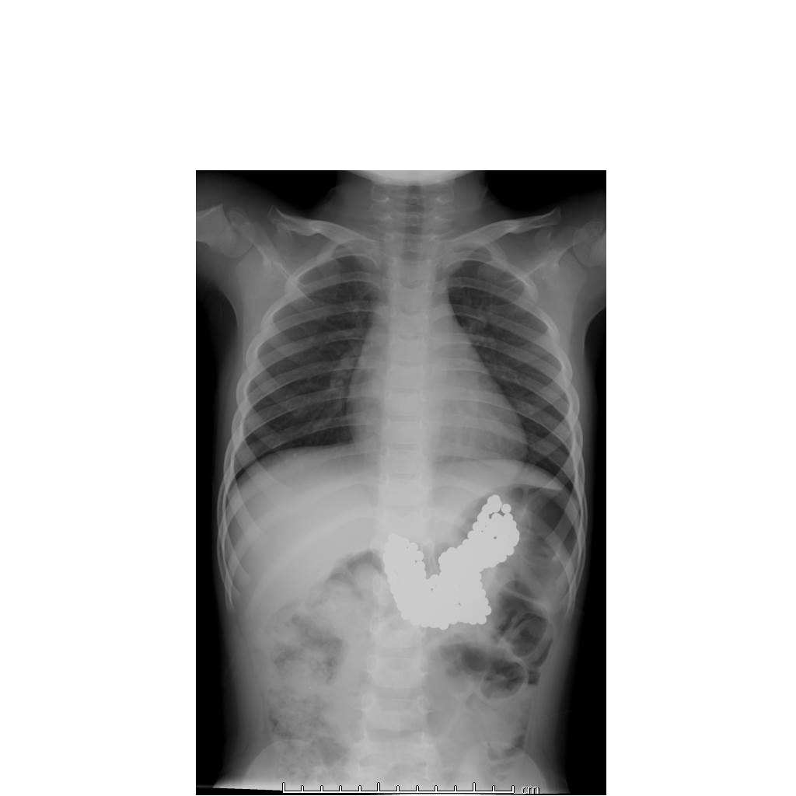

Slide 55
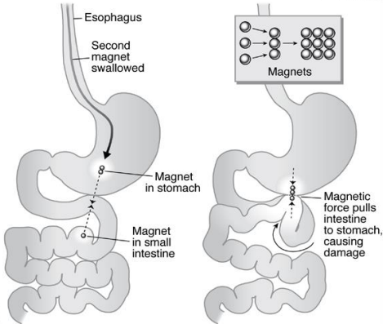
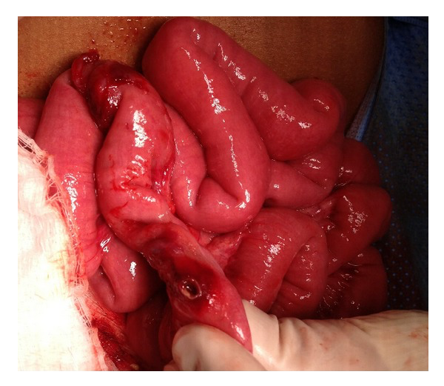

Slide 57
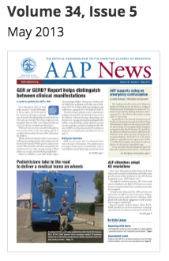

Slide 58
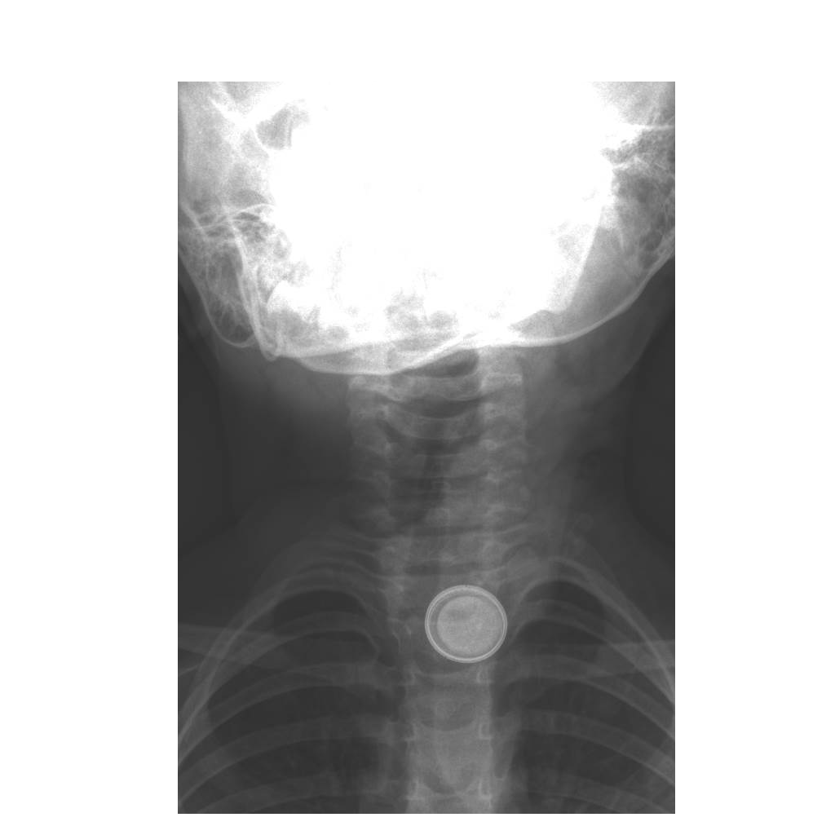
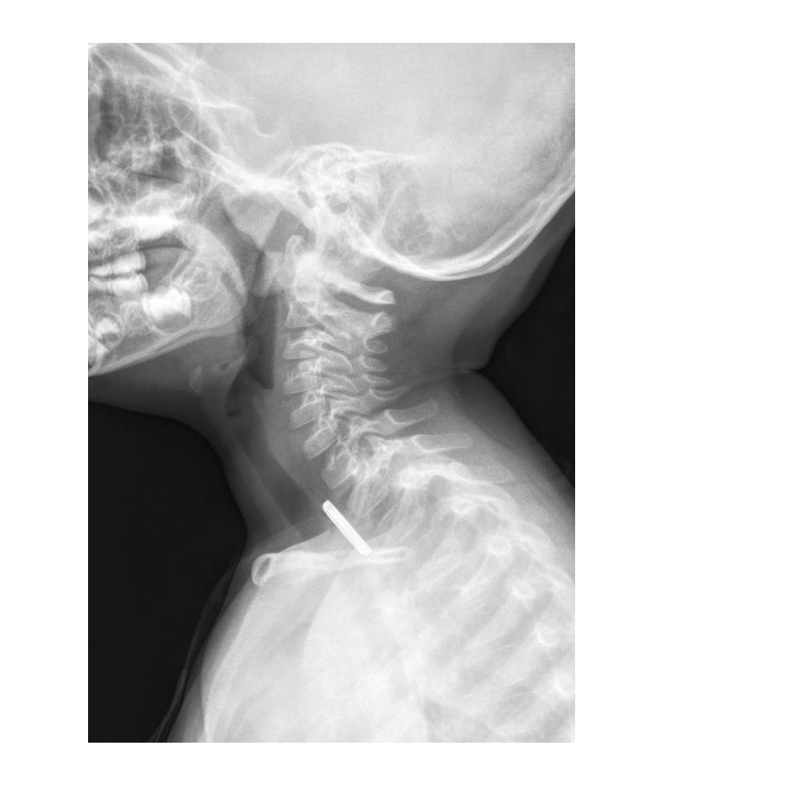

Slide 59
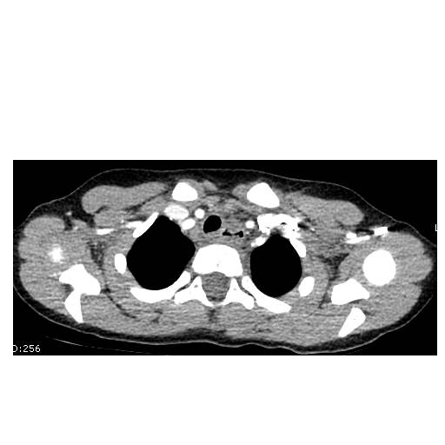
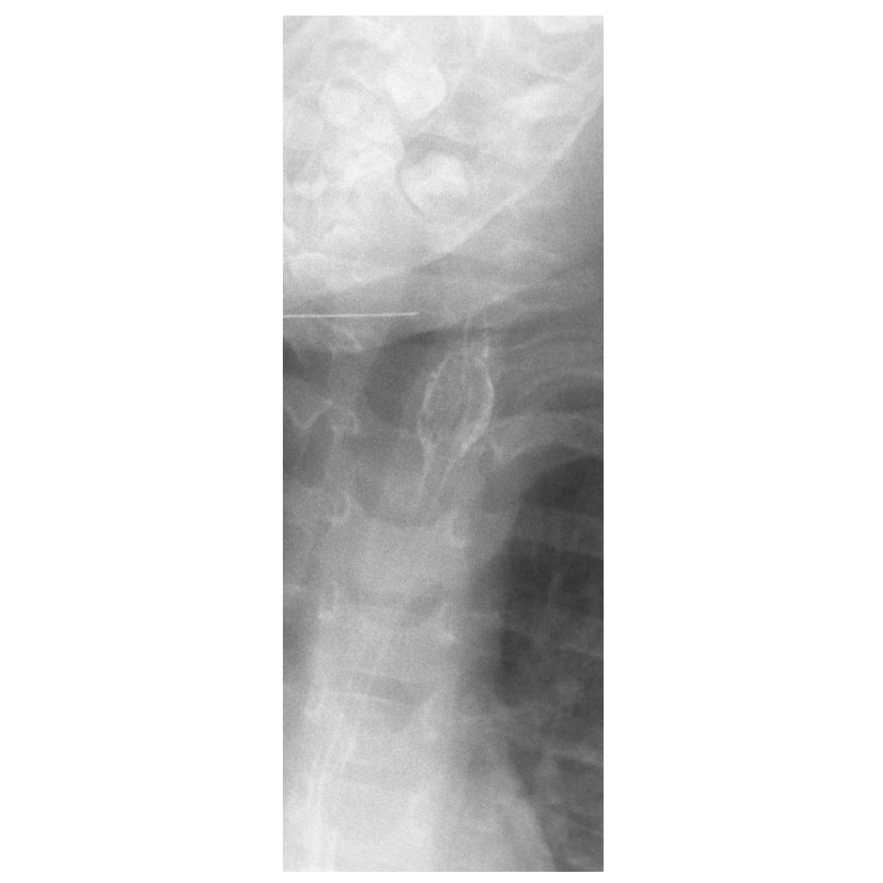
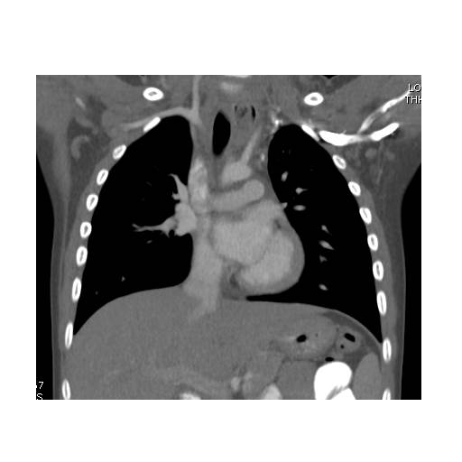

Slide 60
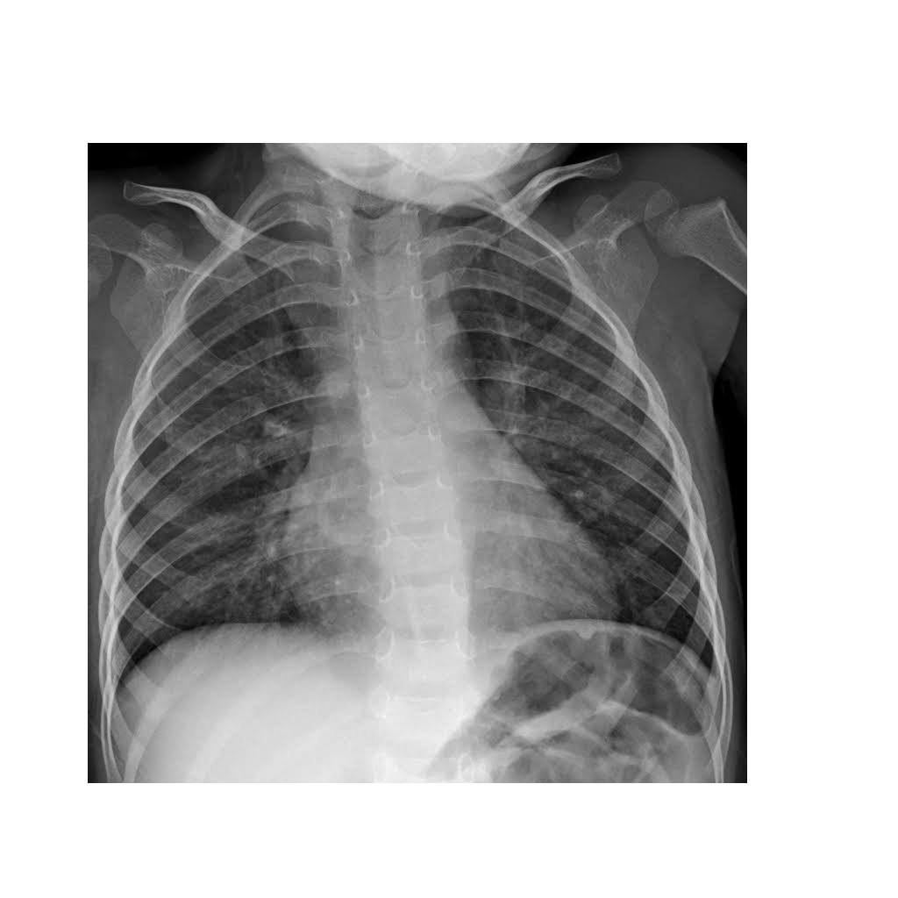
Persistent cough after
eating popcorn

Slide 61
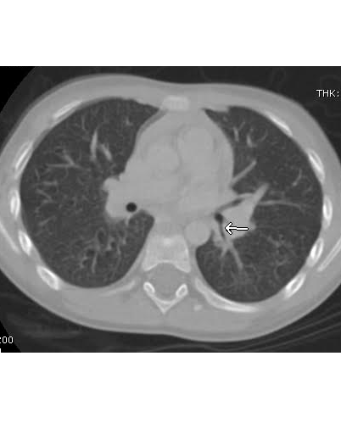

Slide 62
Appendicitis
Ultrasound remains the first line of assessment at our institution
CT for cases of suspected perforation/abscess
Greater utilization of MRI in children => 8 years if appendix not seen by US

Slide 64
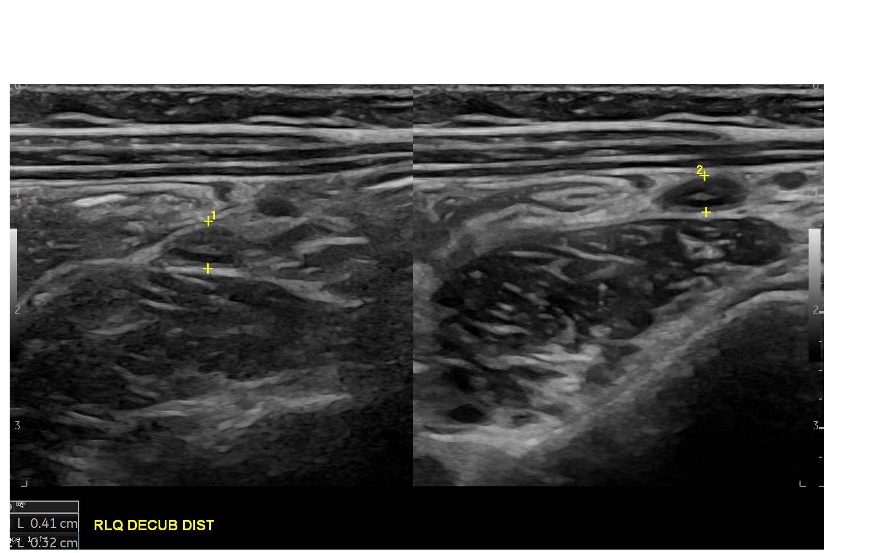

Slide 65
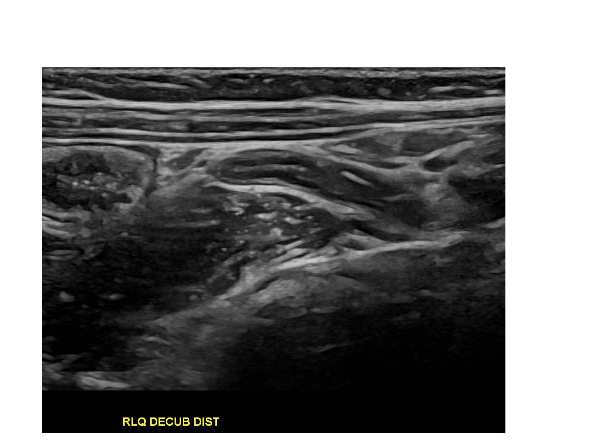

Slide 66
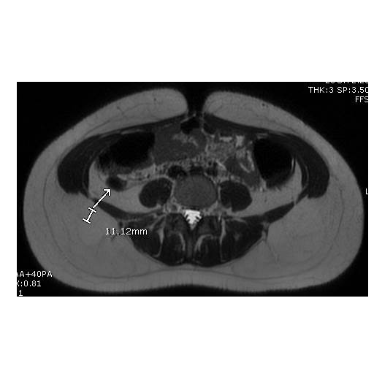

Slide 67
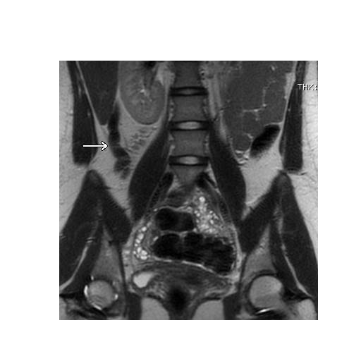
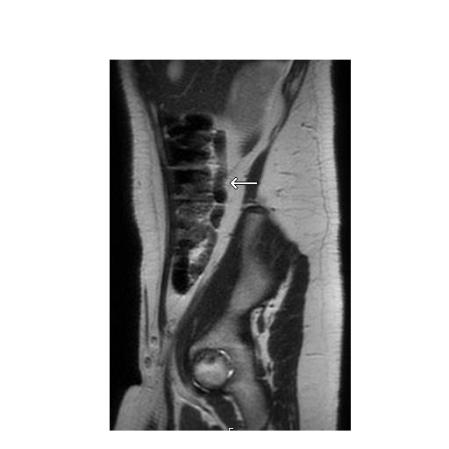

Slide 68
Gonadal Torsion
Why do people wait for days?

Slide 69
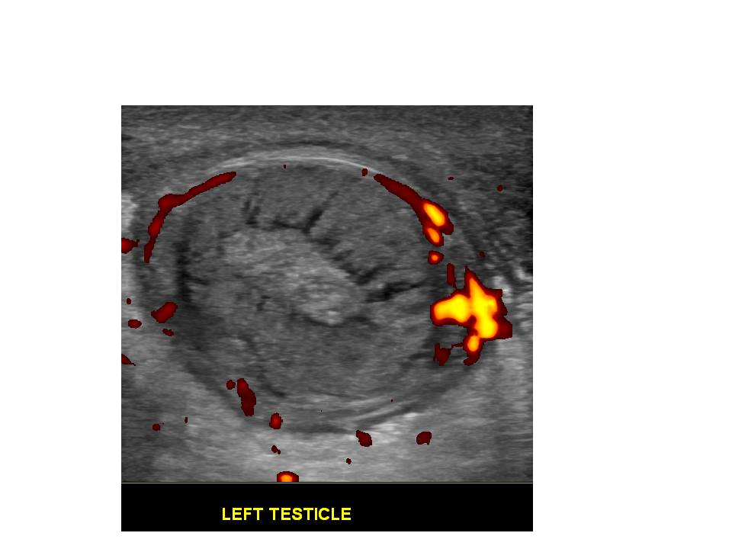

Slide 70
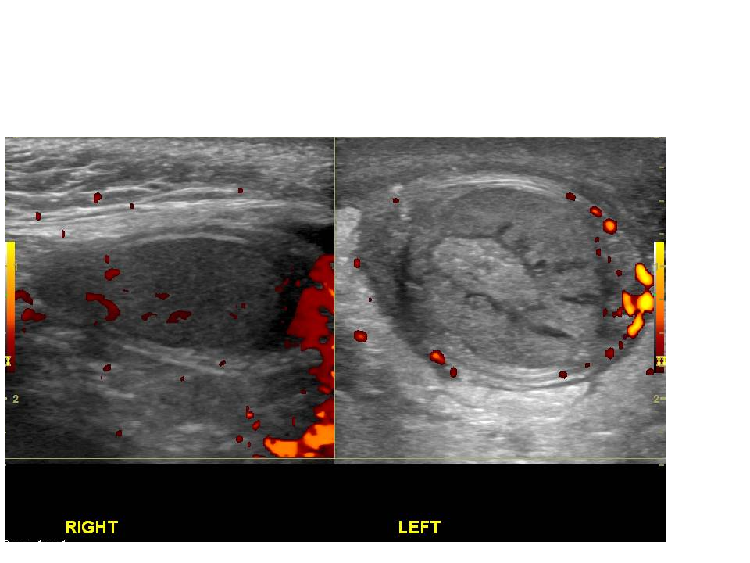

Slide 71
Ovarian Torsion
The presence of Doppler flow in the ovary DOES NOT exclude torsion
The ovary has dual blood supply from the ovarian and uterine arteries
Size matters!
Volume > 40 cc, but could be less
Cysts or other lesions > 5.5 cm predispose to torsion

Slide 73
Incidental Findings
Usually will say what follow up is recommended, if any
e.g. Thyroid US - TI-RADS score used to direct follow up and/or FNA
Recommendations change

Slide 74
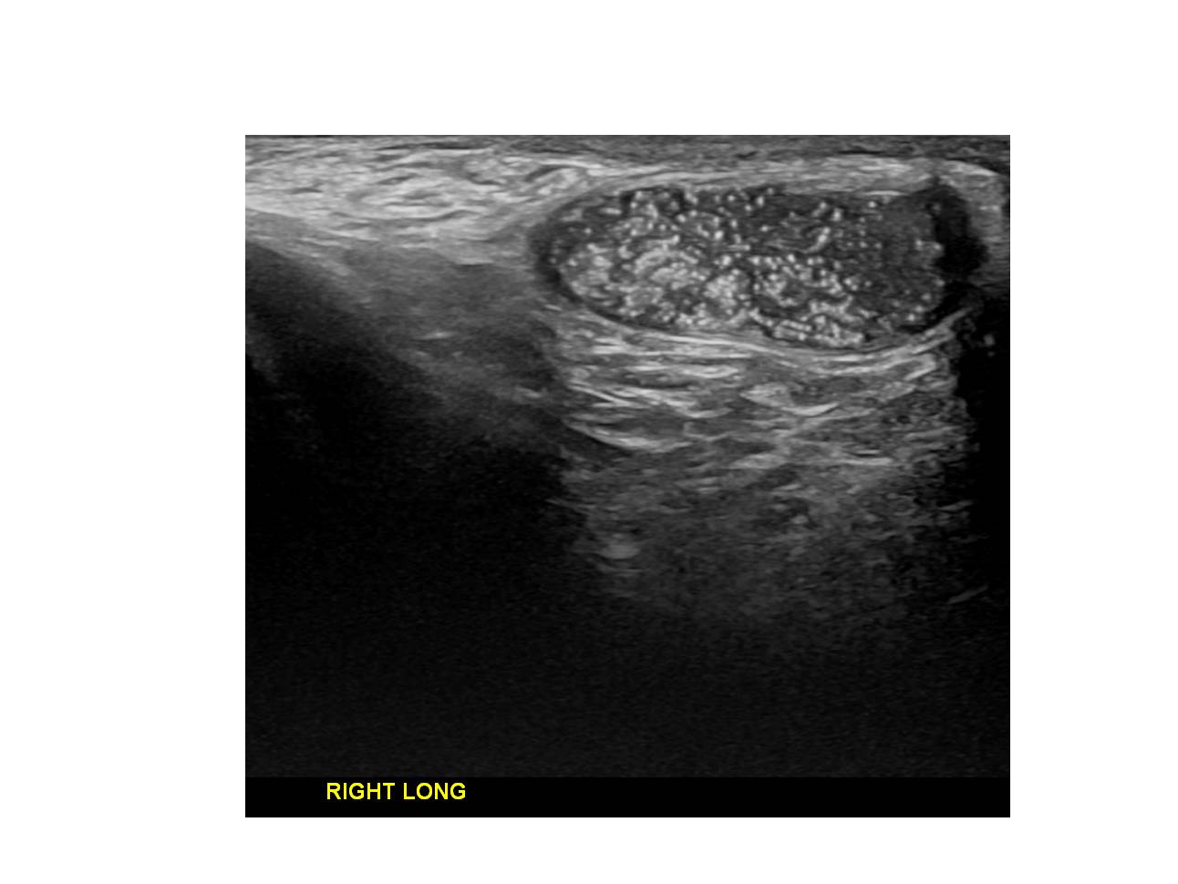
Incidental Findings

Slide 75
Testicular Microlithiasis
Calcification in the seminiferous tubules
Correlation with, not causation of malignancy
No longer recommend ultrasound follow up in the absence of other risk factors (e.g. cryptorchid/undescended testis)

Slide 76
Screening Exams
Emergencies
Preps
Infectious workup

Slide 77
Infants with bilious emesis need emergent evaluation with
Upper GI

Slide 78
Infants with bilious emesis need emergent evaluation with
Upper GI
Stop feeding the child
and call us

Slide 79
Non-emergent GI exams benefit from appropriate preparation

Slide 80
Non-emergent GI exams benefit from appropriate preparation
… but first a few words about the
Barium Swallow

Slide 81
Barium Swallow
Esophagram
(anatomy)
vs.
Modified Barium Swallow or VFSS
with Speech Therapy
(physiology)

Slide 82
NPO Guidelines for Esophagram, Upper GI, Small Bowel
skip a meal:
< 1 year: 3 hours NPO
1-4 years: 4 hours NPO
5-9 years: 6 hours NPO
>10 years: 8 hours NPO*
*preferably overnight

Slide 83
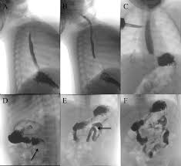
Upper GI:
assess anatomy (not to see reflux)
see through ligament of Treitz

Slide 84
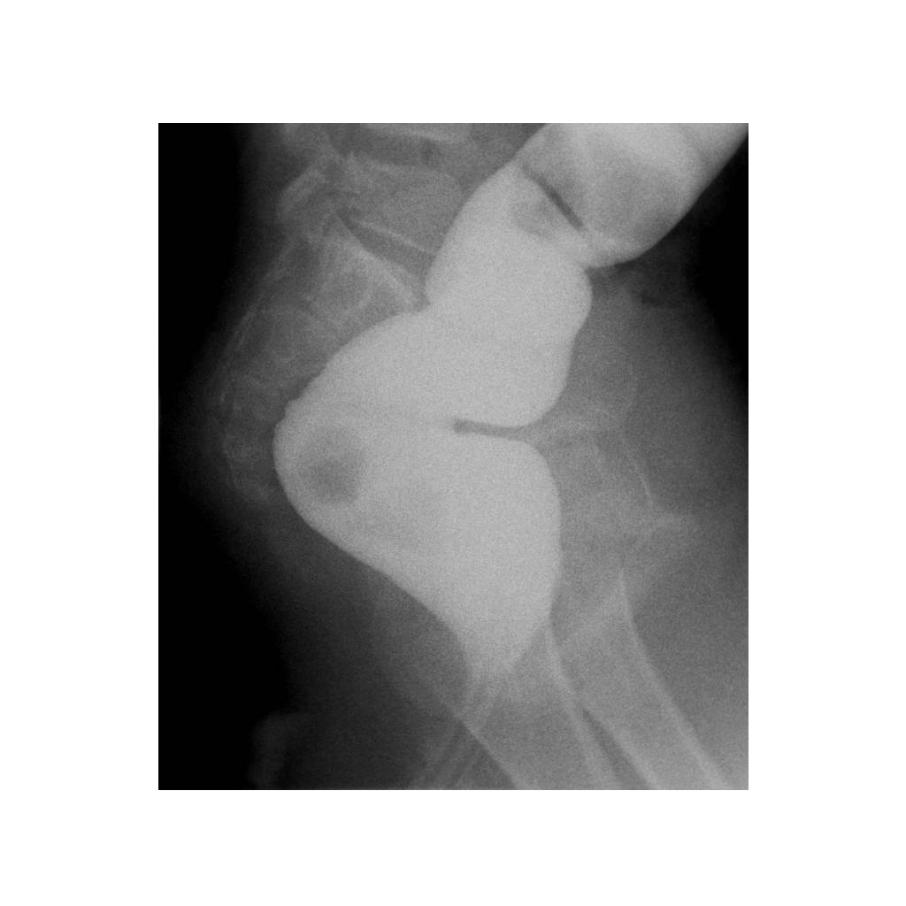
No prep for Contrast Enema
Possible Hirschsprung ->
Nothing per rectum for 24 hours

Slide 85
No prep for Contrast Enema
Possible Hirschsprung ->
Nothing per rectum for 24 hours
No prep for VCUG
Recent febrile UTI/pyelonephritis ->
Afebrile, on antibiotics => 48 hours

Slide 86
Aside:
Are you ordering enough VCUGs?

Slide 87
Febrile UTI.
No hydronephrosis.

Slide 88
Bilateral Grade 4-5 VUR

Slide 89
Ultrasound Exams
Are you ordering what you intend?

Slide 90
Ultrasound Exams
Are you ordering what you intend?
US Abdomen Complete

Slide 91
Ultrasound Exams
Are you ordering what you intend?
US Abdomen Complete
… some of the best imaging marketing ever!

Slide 92
Ultrasound Exams
Are you ordering what you intend?
US Abdomen Complete
Examination of the solid organs of the upper abdomen and the gallbladder.
Does not include RLQ (Appendix), LLQ, Pelvis (Ovaries) or Pylorus

Slide 93
Many Ultrasound exams require fasting as well
Abdomen Complete, RUQ: NPO (skip a meal)
Gallbladder will be contracted with any fatty meal/feed

Slide 95
Many Ultrasound exams require fasting as well
Abdomen Complete, RUQ: NPO (skip a meal)
Gallbladder will be contracted with any fatty meal/feed
Doppler - assess blood flow to organ or in vessel and/or clot. Abdominal Vascular Exams (e. g.
Renal Artery, Liver Doppler, Aorta/IVC/Iliacs):
NPO (skip a meal)

Slide 96
US Pelvis Complete
Need full bladder
US Renal (and Bladder)
No void 1 hour prior to exam

Slide 98
Screening Exams
Emergencies
Preps
Infectious workup

Slide 99
Infectious Workup: CT and MRI

Slide 101
Computed Tomography (CT)
CT scan only once
With IV contrast to evaluate tumor, infection, vasculature, trauma
With enteric contrast to delineate bowel from adjacent tissues
IV contrast excreted by kidneys; allergies in children are rare
New FDA guidance on IV contrast in young, at risk children

Slide 105
Risk of transient hypothyroidism in patients birth through 3 years
Additional risk factors:
Very low birth weight
Prematurity
Cardiac or other conditions requiring NICU/PICU (related to volume of contrast?)
Recommend thyroid screening within 3 weeks

Slide 106
Follow up
Contrast administration in patients 0-3 years age will be noted in radiology and ED records
Pediatric Endocrine Society recommendations:
TSH level between 2 and 3 weeks after iodinated IV contrast administration
PSV Endocrinology: 703-778-1234

Slide 107
Computed Tomography (CT)
Certain Xray exams have many views (and positioning attempts) and provide much less information
Lower dose (bone) CT protocols are now similar to Xrays
CT is therefore recommended in sinus and maxillofacial evaluation due to significantly greater anatomic detail

Slide 109
Medical radiation saves lives
Image only what and when you have to

Slide 110
Covid Pneumonia

Slide 111
Covid Pneumonia
Will CT change management?

Slide 112
Covid Pneumonia

Slide 113
Always on
Apply gradients to cells and generate images based on cellular characteristics
Protocols and preps specific for each exam
Must hold still !!
Swaddle, child life, anesthesia

Slide 114
Magnetic Resonance Imaging (MRI)
Multiplanar, multisequence examination
Noncontrast images first
Without and with IV contrast to evaluate tumor, infection, vasculature

Slide 116
Questions/Consultations 703-776-3262

Slide 117
Questions/Consultations 703-776-3262 Thank you!

